Slide 1
THE HEART OF THE MATTER
Technical considerations for furthering heart-centred maternal care in South Africa

Slide 2
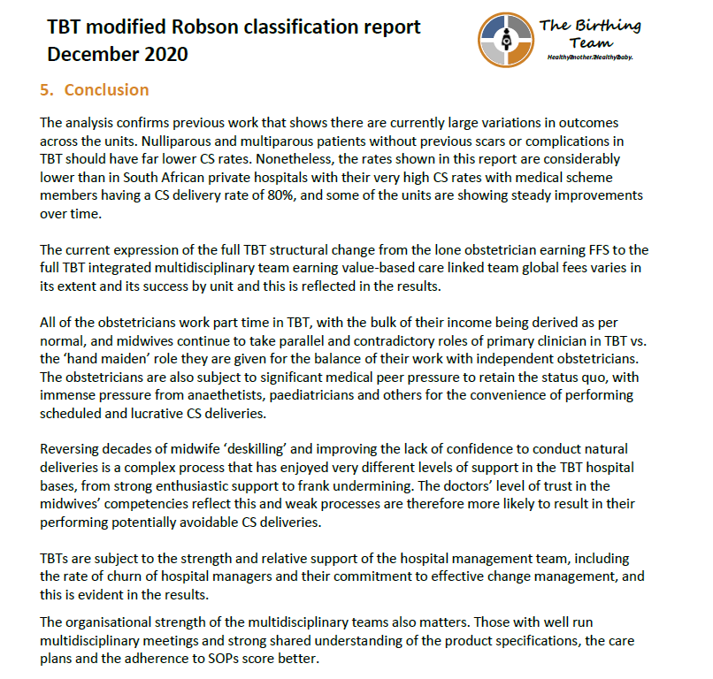


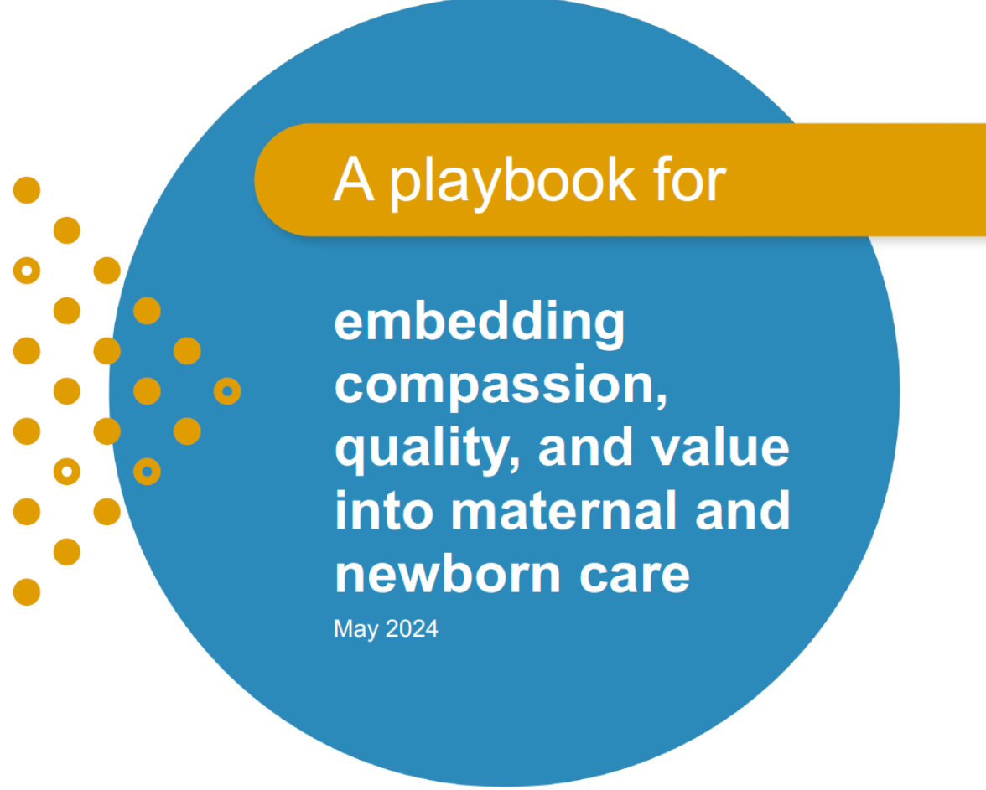
NECESSARY CONFLUENCE
NOW
Birthing Team pioneering
Emergent new models
The Usha Lesizalo Playbook
Public sector strategic purchasing
HPCSA MDT reform

Slide 3
NECESSARY SPECIFICITY
Embedding Equity
Same measures of outcomes that matter
Same pathways
Goldilocks
Too little, too little, too much, too much
Re-balancing across sectors through attending to the details of HRH, medico-legal challenges, contracting
Why Maternity?
Maternity is ideal: medical + surgical; outcomes that are globally visible; broader social impact is immense
Centring dignity

Slide 4

DELIVER-MEASURE-PAY
Reimbursement reform without the other elements of system change has limited effect
Clinical protocols
Team structures
Midwife reskilling
Paying close attention to the care pathways and pain points ensures an improvement orientation
Deliver
Neutrality
Measuring what matters ensures clear alignment on true value
Measure
Pay

Slide 5
ARCHITECTING THE WORLD WE WANT
Reimbursement Design
Double-layered consideration: remuneration at a team level AND remuneration of each team member.
Balancing alignment and simplicity
How do we architect reimbursement to…
Reward improvement? | Measure what matters to patients. Agree measures. Link reimbursement to quality. FFS + measurement Performance based FFS Performance based bundled fees
Support teamwork? | Bundled team-based fees and enable team communication.
Enable co-ordination of care? | Building the cost of care coordination into bundled team-based fees
Ensure a continuum of care? | Bundled fees for an episode of care
Stimulate innovation? | Bundled fees team-based episodic fees + measurement of value
Ensure preventative care? | Fee for service (believe it or not)

Slide 6
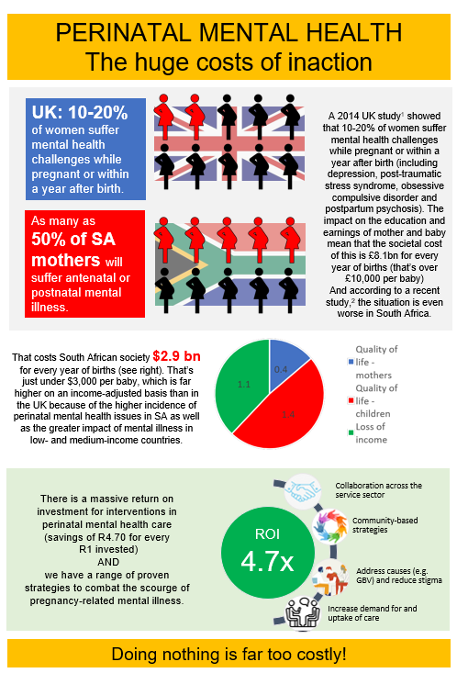
A MULTIPLICITY OF CARE PATHWAYS
Recognising the nuances of experiences and risk
Full episode of care from the perspective of the mother: from knowledge of conception until ??
Pre-natal | BIRTH | Post-natal
Low-risk Pre-existing conditions Terminations Miscarriage Emergent high-risk
 | Low-risk Stillborn Pre-term Multiple Complicating
 |  | Low-risk Mental health Pre-term NICU Baby screening
Many possible pathways: HIV, gestational diabetes, pre-eclampsia…

Slide 7
BOTTOM-UP COSTING
Technical work that is compassion-centred
Pioneers and emergent models of care and international experience give us excellent starting points: team inputs; relative costs
Starting with existing costs of care is problematic because of the extent of the inefficiencies built in
There are structural differences between sectors, such as tax and medico-legal insurance, that need to be accounted for
Fair, compassionate pricing has to find the tension point between what is patient-centered, what is sustainable for providers and what is affordable

Slide 8
MICROCHANGE AT SCALE
Supporting the emergence of new models of care over time
Deliver: A realistic integrated model of care as a starting point
Measure & Pay
Update payment as new models emerge
model 3
model 2
model 1

Slide 9
MICROCHANGE AT SCALE
Multiple potential pathways
Begin we must
Pilot sites
Learning from shifts in how care is delivered
Testing and refining outcomes measurement
Driving medico-legal reform
Expanding the episode of care
Experimenting with remuneration models
Expanding the nuanced care pathways
Pilot
Iterate
Test
Expand
Refine
Learn
Improve
Embody & Invite

Slide 10
Thank you

