Slide 1
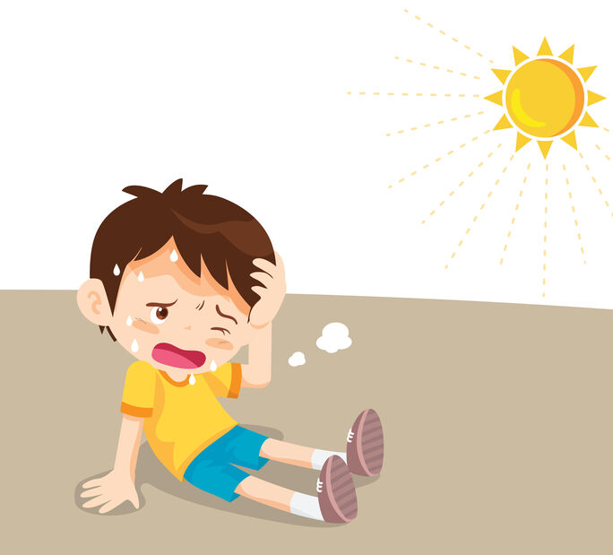
Climate change-related health impacts in the world, Africa and South Africa
Why should we be worried?
Caradee Y Wright
(PhD Public Health)
Climate Change and Health Research Programme Lead
Environment and Health Research Unit
South African Medical Research Council
5 November 2024

Slide 2
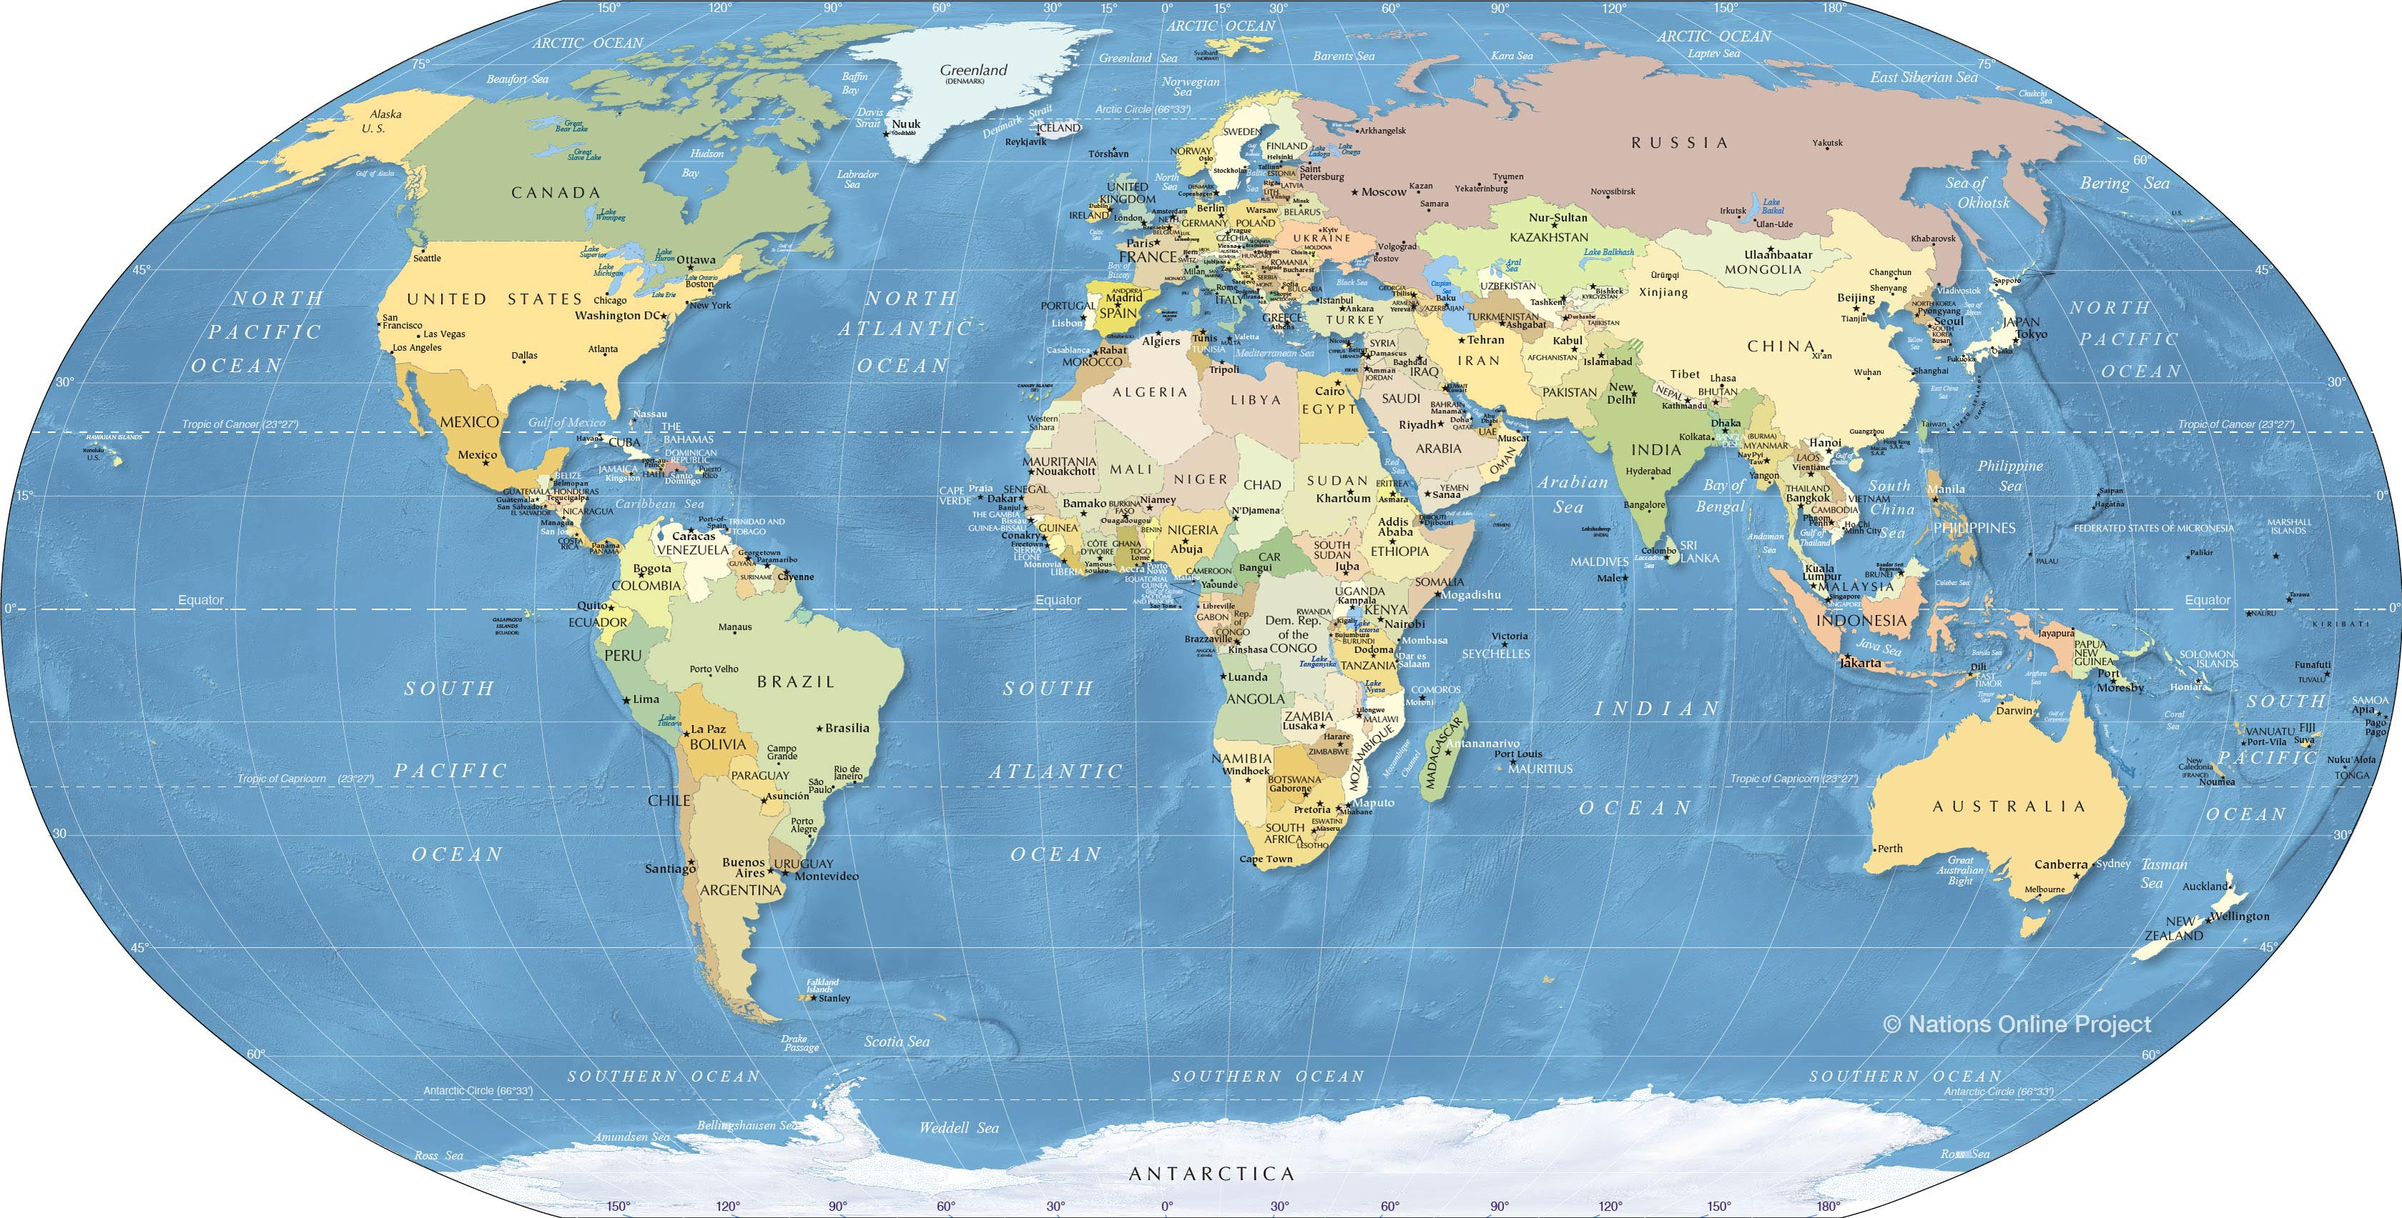
People are dying from climate change
Findings from the 2022 Report of the Lancet Countdown: Tracking progress on health and climate change
  Extreme heatwaves in 2020 were associated with 98 million more people suffering from food insecurity than annually in 1981-2010.
  Heat exposure led to 470 billion potential labor hours lost globally in 2021.
  Life-threatening extreme weather events are becoming increasingly frequent, and weather conditions are becoming more suitable for the spread of infectious diseases.

Slide 3
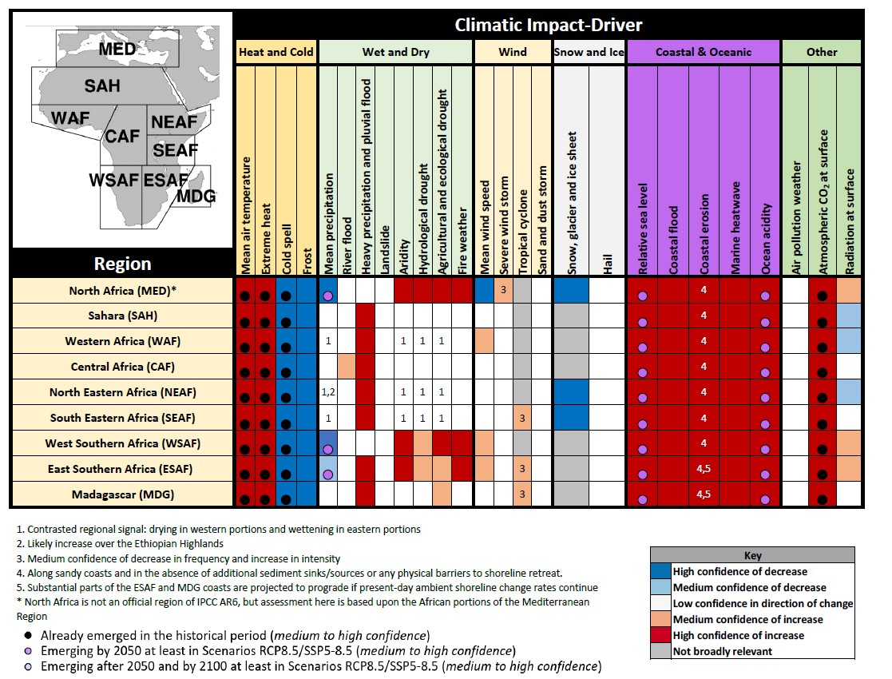
What’s happening in Africa?
IPCC AR6 Africa Chapter 2021
Summary of confidence in direction of projected change in climatic impact drivers in Africa
Climatic impact drivers are drivers of impacts that are of climatic origin that affect an element of society or ecosystems
IPCC AR6 Chapter 9, 2021
Notes:
Impacts are caused by changes in the climatic drivers. Give example of such changes in Africa using the Easter Southern Africa row as an example.

Slide 4
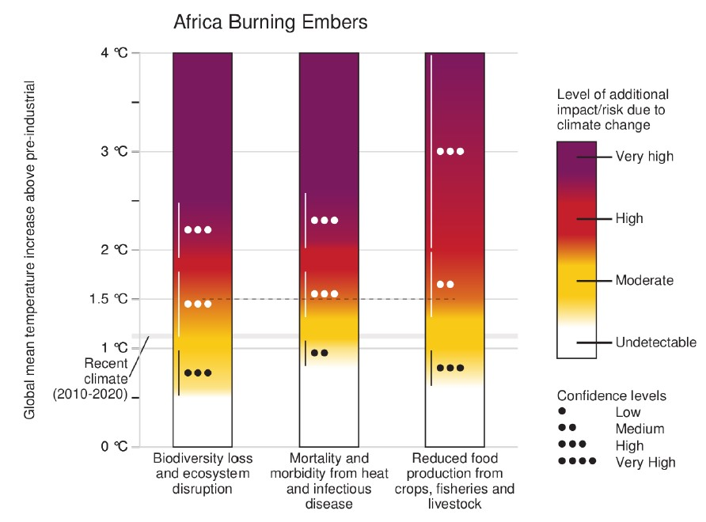
Things have changed, and they will change more for the worse
Globally, 12 million lives are lost every year from living or working in unhealthy environments

Slide 5
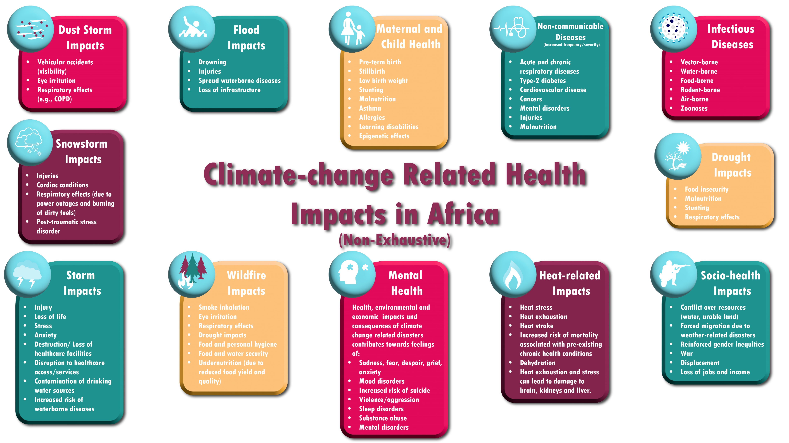
©CaradeeWright2024
Notes:
Introducing the climate-change related health impacts - not only in Africa but in most countries around the world. Don’t go through them all.

Slide 6
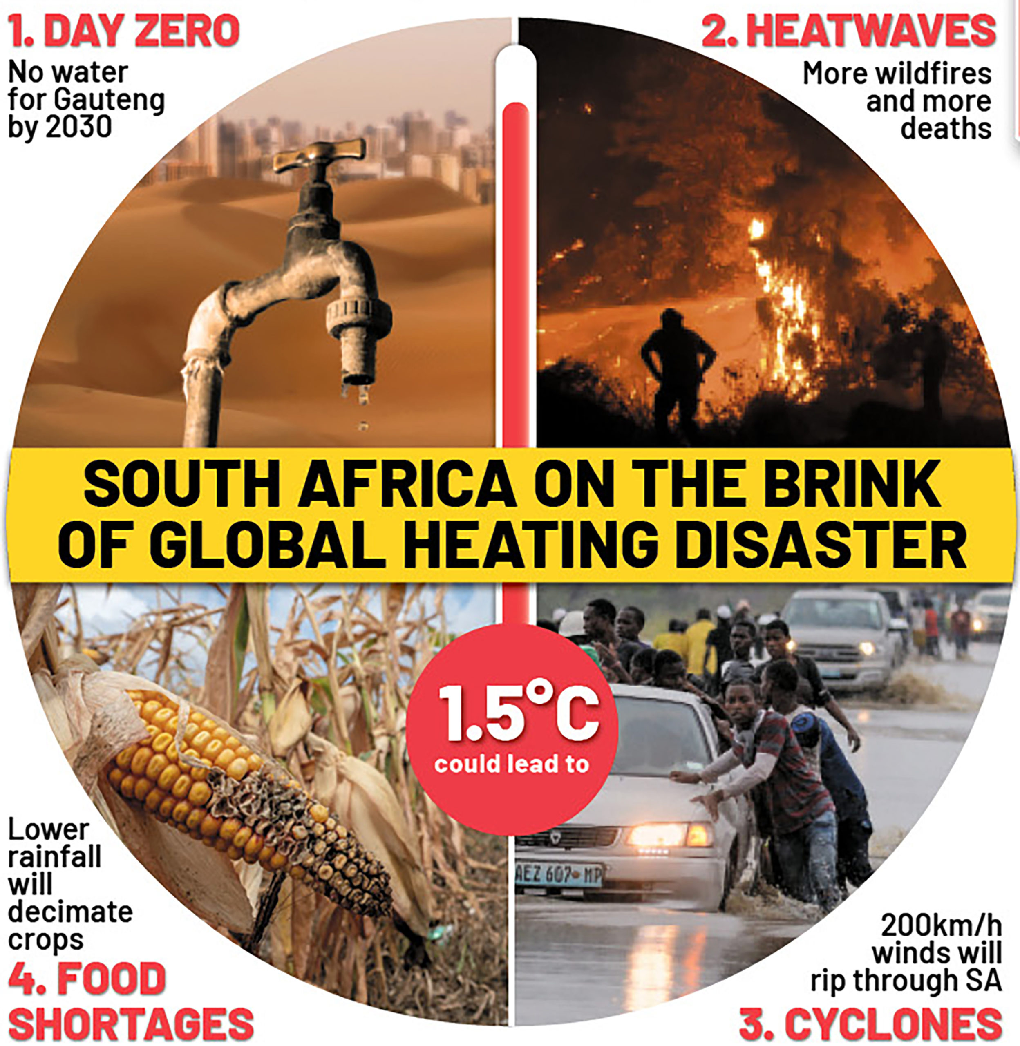
Climate change and health impacts in South Africa
Pressing climatic changes:
  Increase in ambient temperature
  Increase in hot days / heatwaves intensity
  Heavy rainfall
  Flooding
  Drought
  Air pollution
  Dust storms
Health impacts include:
  Mortality
  Cardiovascular / cardiorespiratory
  Heatstroke
  Diarrhea
  Infectious diseases
  Injuries
  Etc.
Source: Daily Maverick

Slide 7
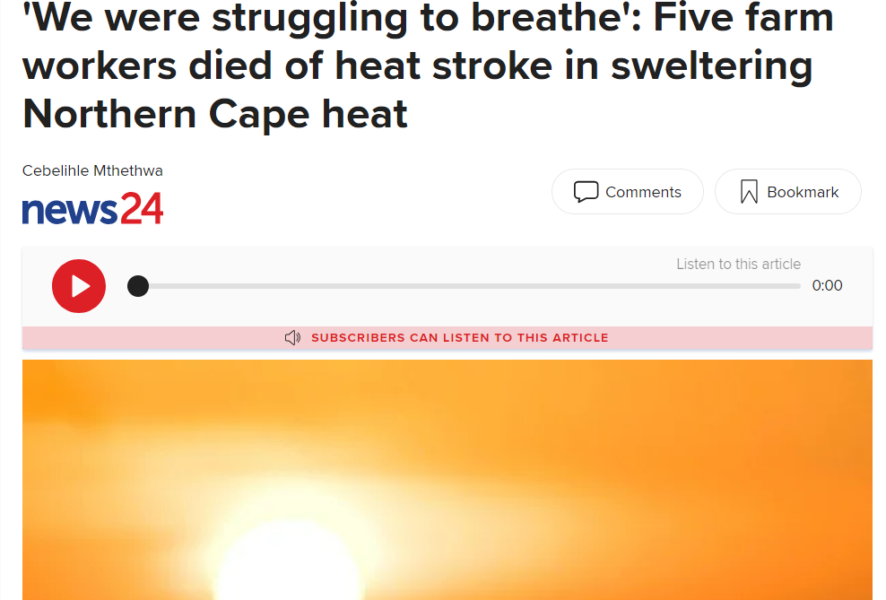
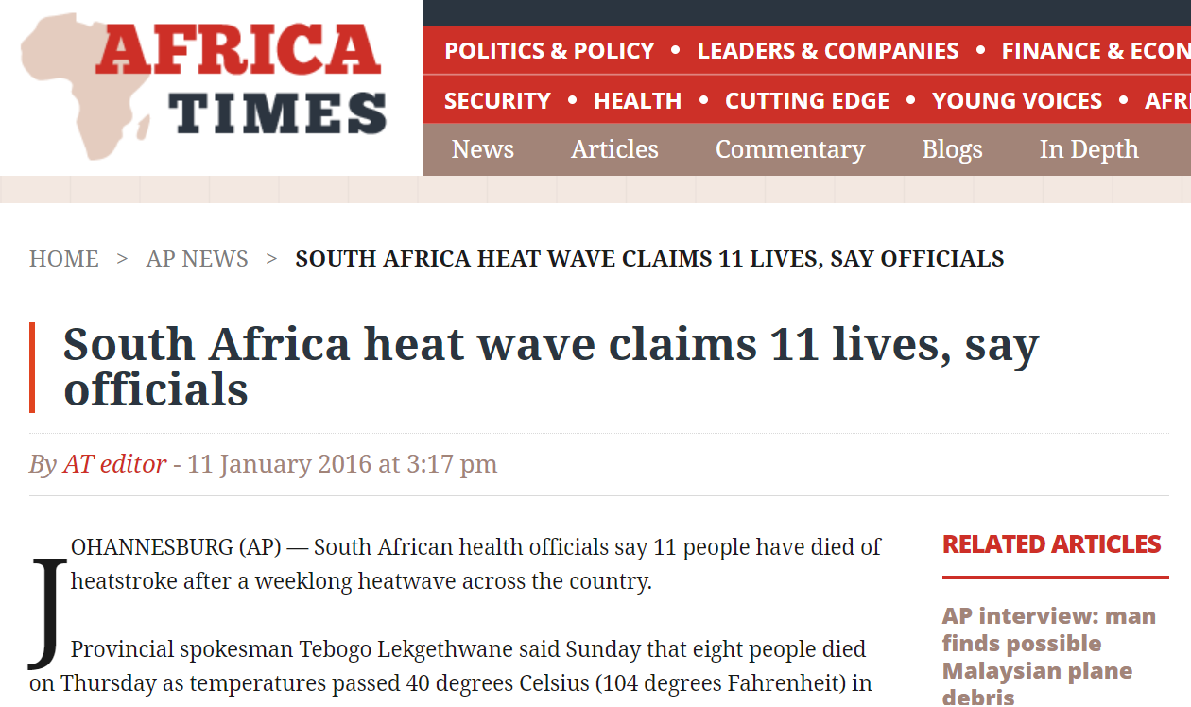
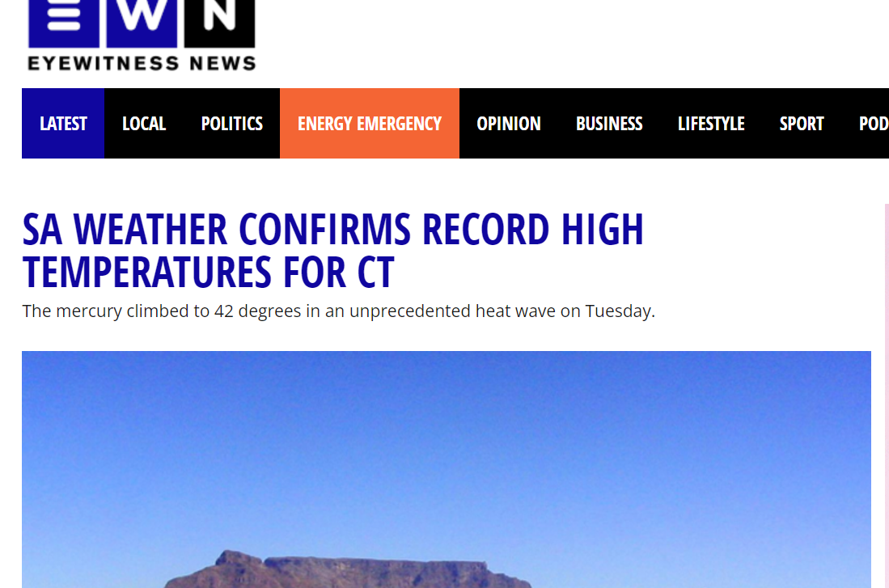

Slide 8
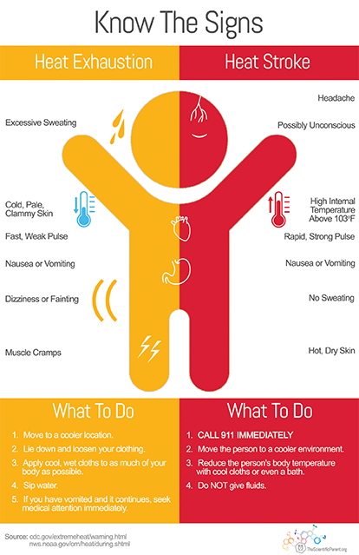
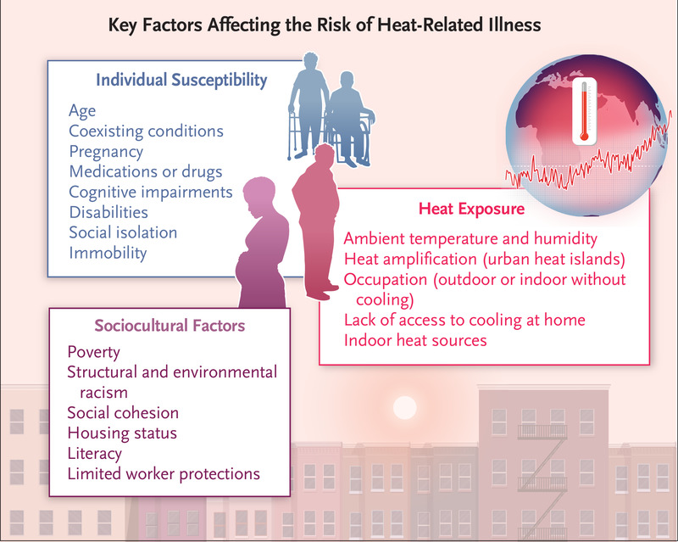

Slide 9
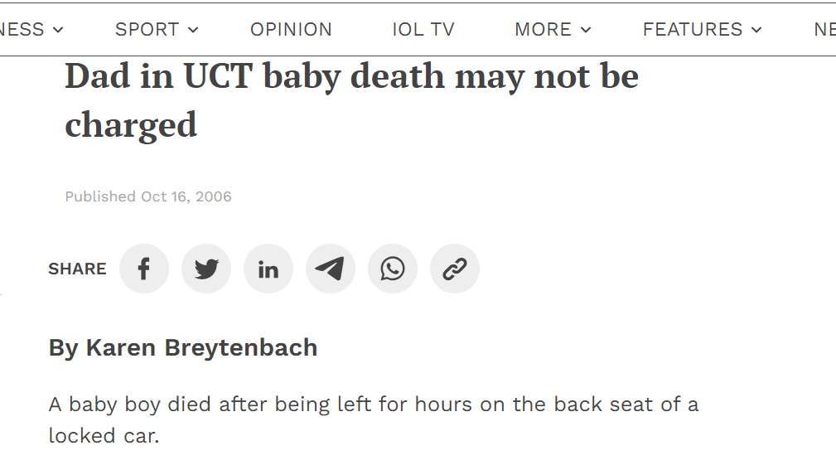
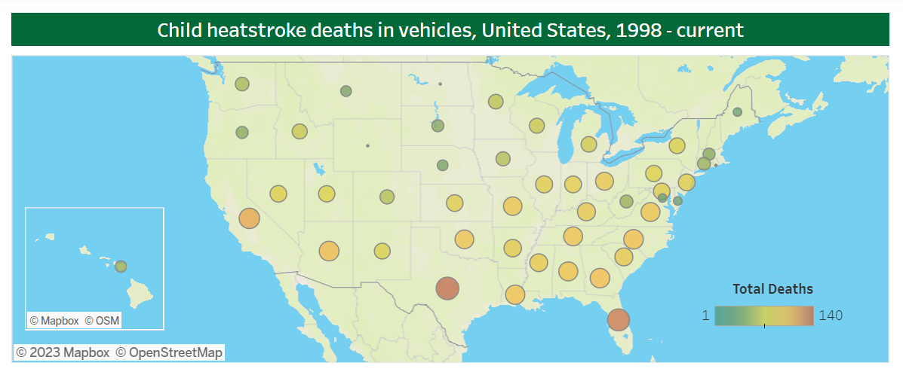
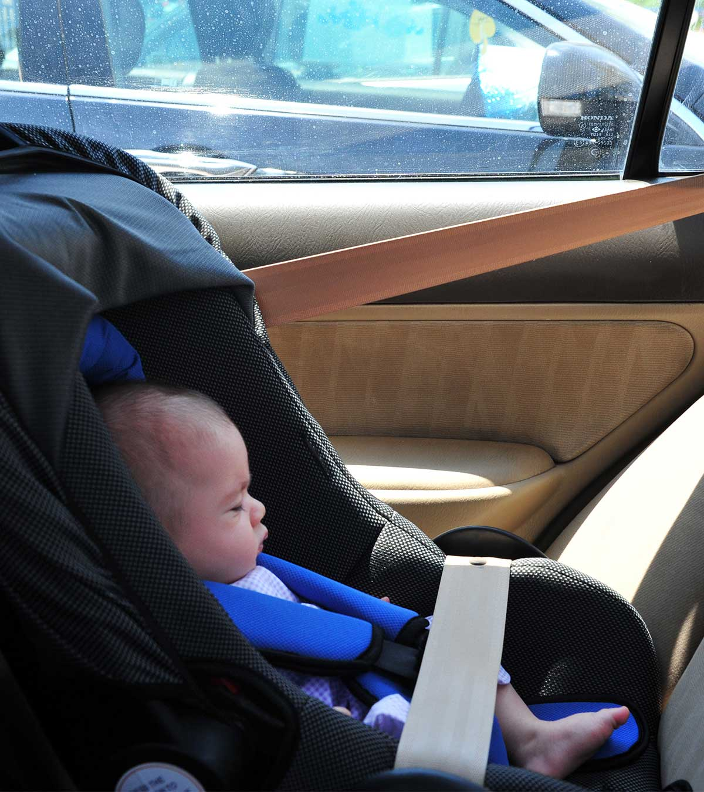
Pediatric Vehicular Heatstroke
Children's thermoregulatory systems aren't as efficient as adults and their body temperatures warm at a rate 3 to 5 times faster.
A child's body has a greater skin surface area to mass ratio than an adult's, which means they absorb heat more quickly.
Children also don't sweat as much as adults do, making them less able to lose heat through evaporative cooling.
On average, 38 children under 15 years die from heat stroke after being left in a closed vehicle in the USA each year.

Slide 10
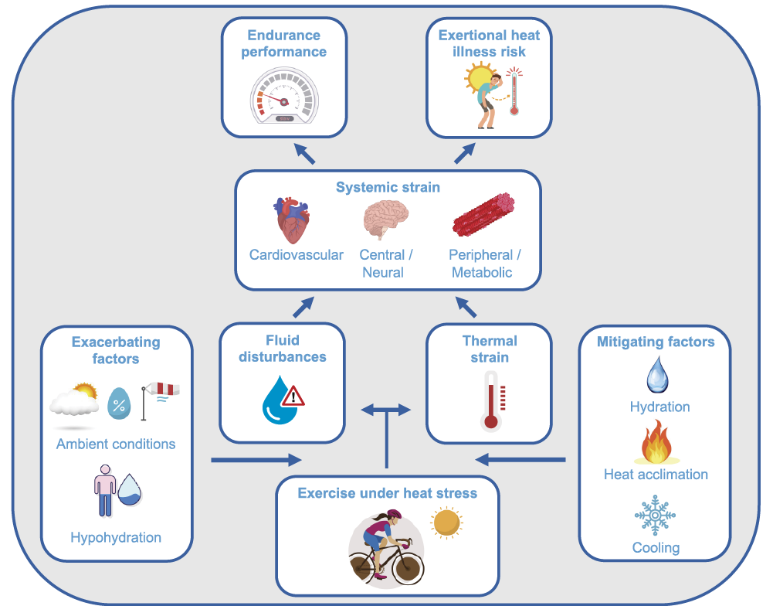
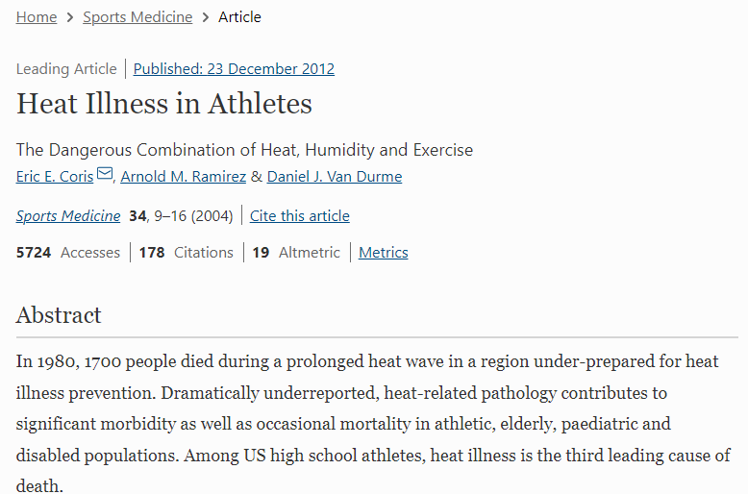
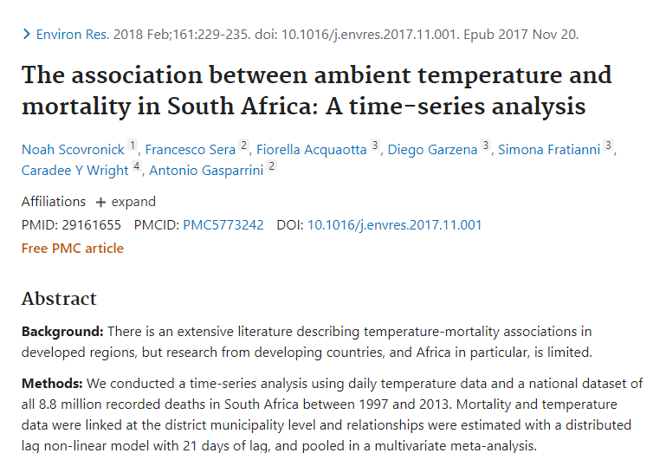
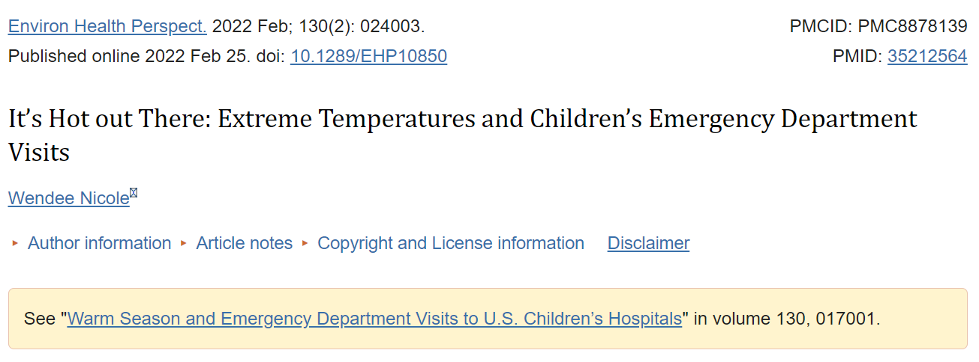
Ambient heat exposure and child heatstroke
Pediatric exertional heat stroke occurs in young, otherwise healthy individuals who engage in heavy exercise during hot and humid conditions.
ICD-9 code E900: “excessive heat—hyperthermia”—specifically subpart E900.0: “due to weather conditions.”
ICD-10 code X30: “exposure to excessive natural heat—hyperthermia.”
Notes:
Scovronick: the strongest associations were in the youngest (< 5) and oldest (> 64) age groups and for cardiorespiratory causes. Very few / none

Slide 11

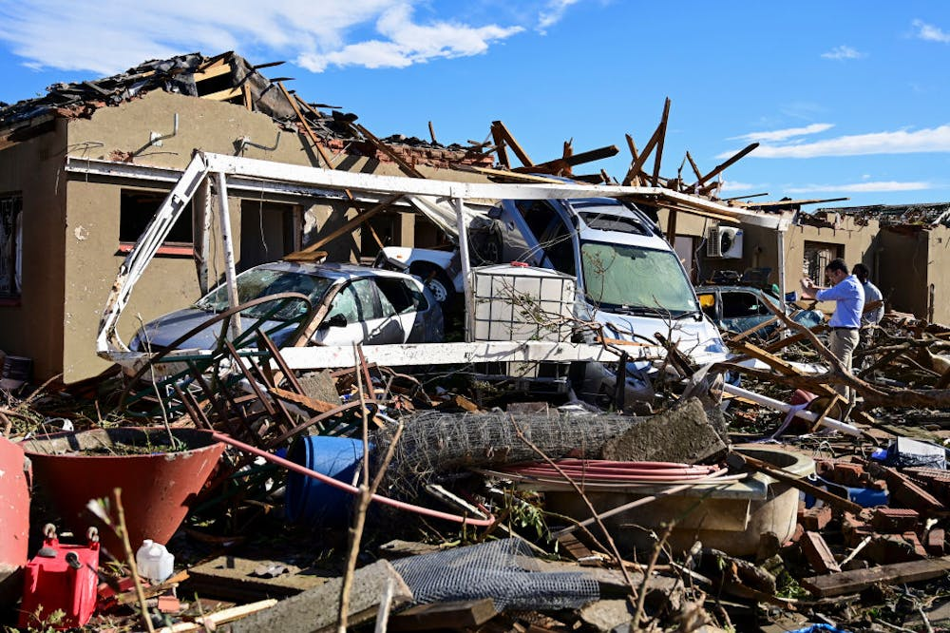
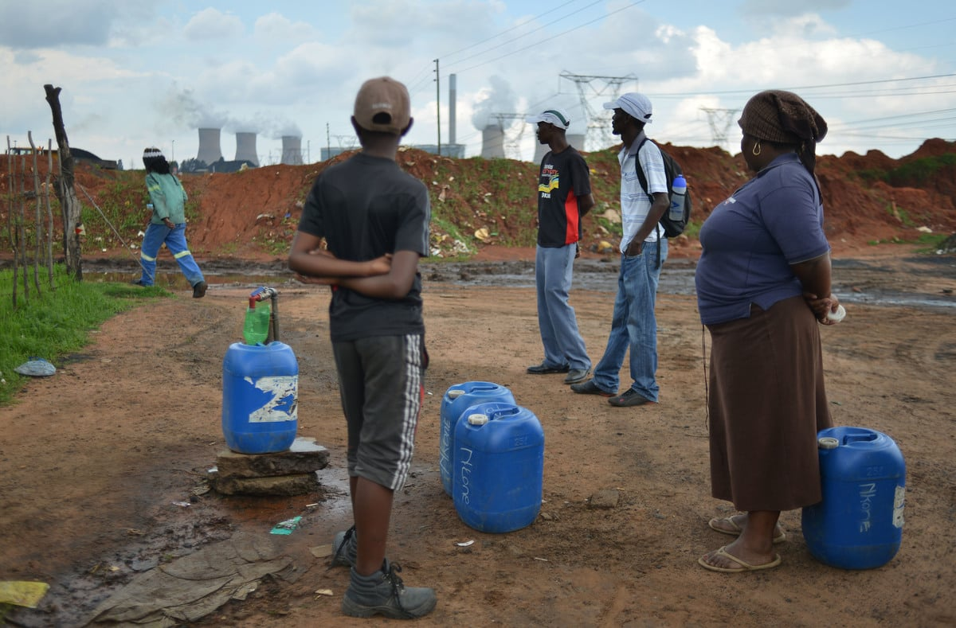
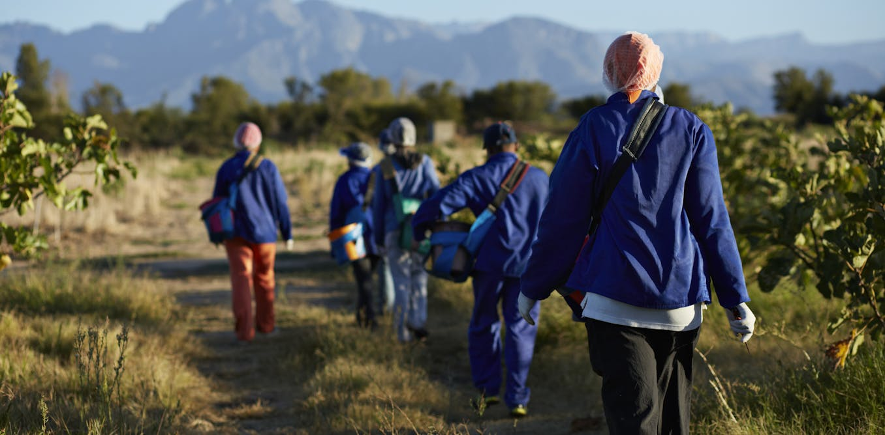
Environmental health and extreme weather events

Slide 12
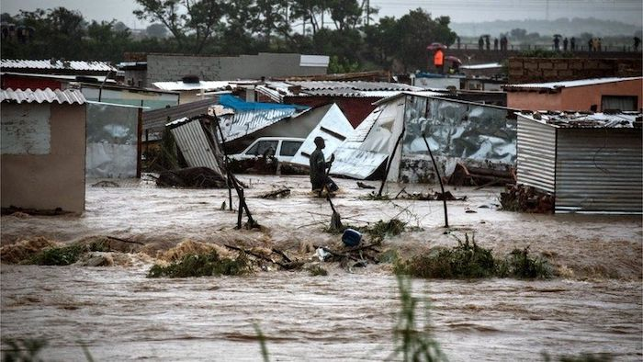

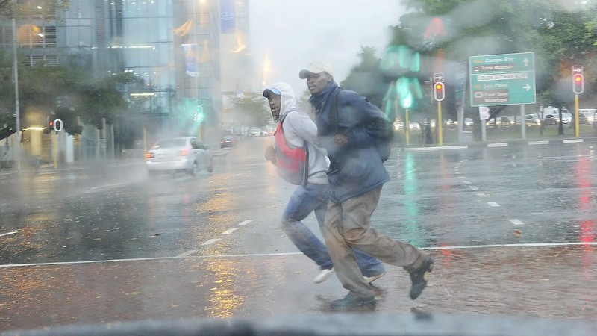
Environmental health and extreme weather events

Slide 13
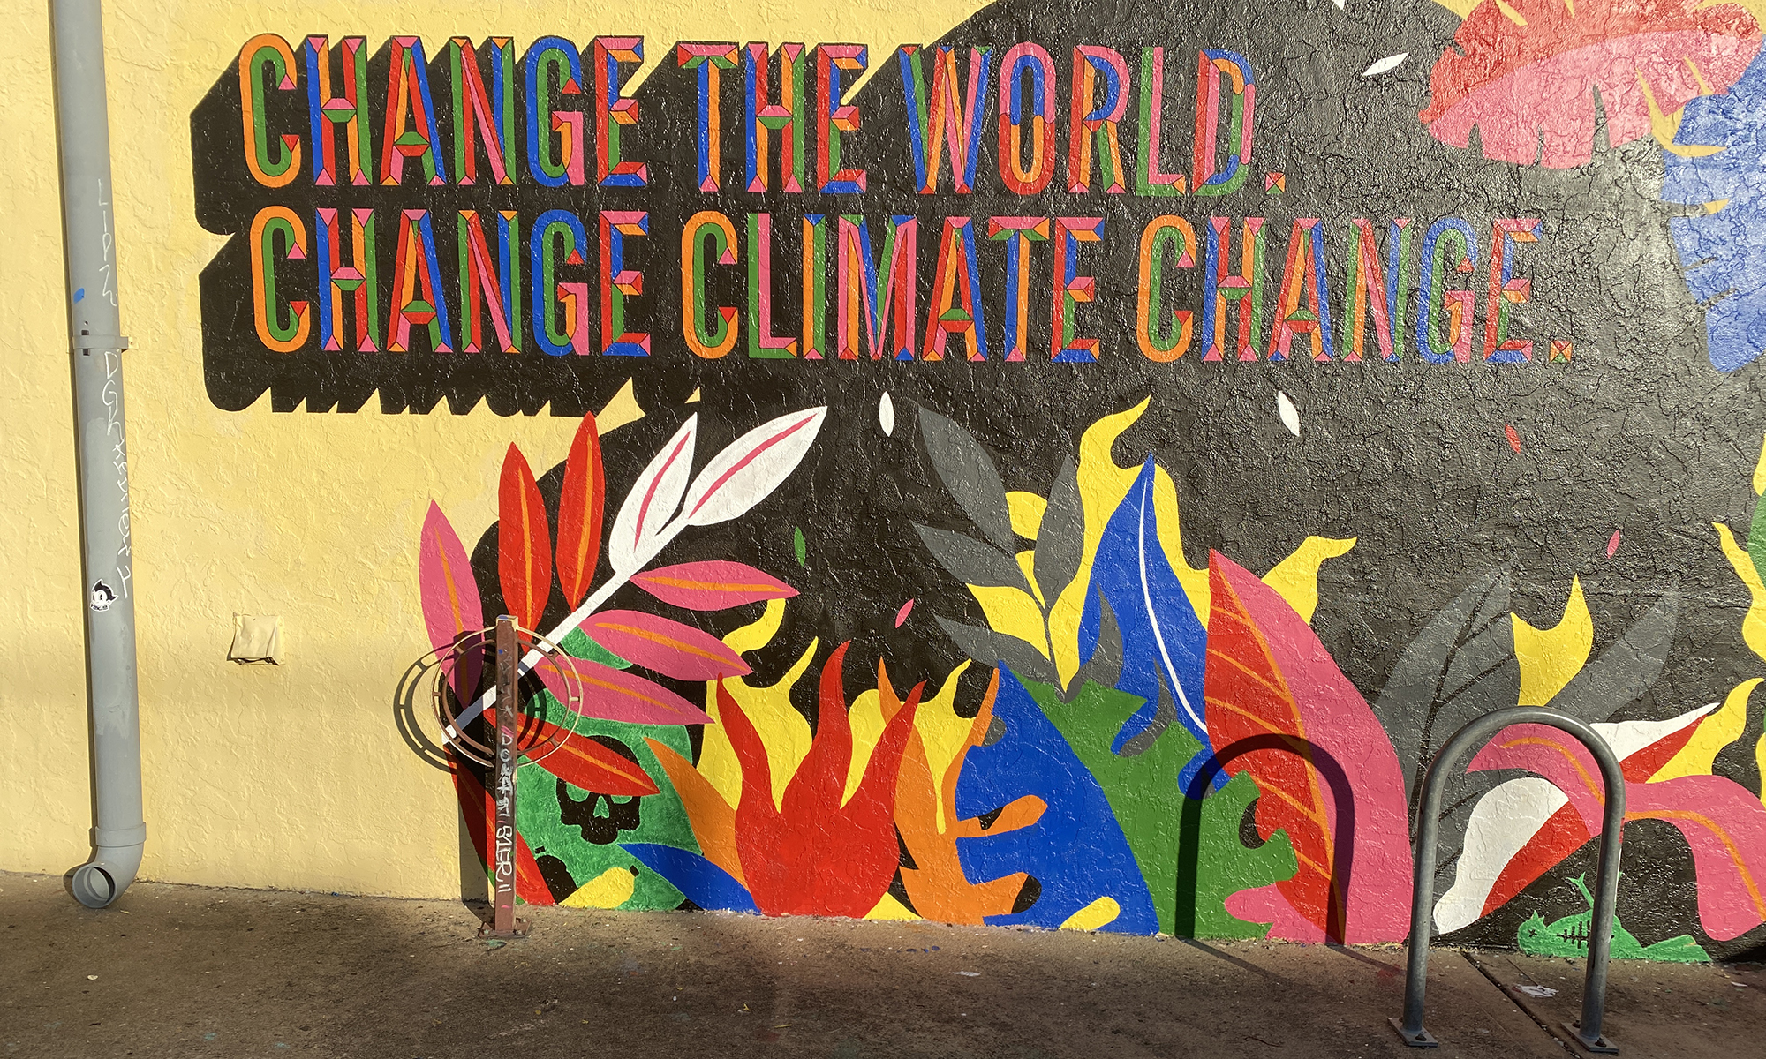
Reference
Caradee Y. Wright, Thandi Kapwata, David Jean du Preez, Bianca Wernecke, Rebecca M. Garland, Vusumuzi Nkosi, Willem A. Landman, Liesl Dyson, Mary Norval, Major climate change-induced risks to human health in South Africa, Environmental Research, Volume 196, 2021, 110973, https://doi.org/10.1016/j.envres.2021.110973.
cwright@mrc.ac.za

