Slide 1

Attributable fractions for cancer
Approaches and insights
David Whiteman AM FAHMS FAFPHM B Med Sc MBBS(Hons) PhD
NHMRC Leadership Fellow
Head, Cancer Control Group

Slide 2
Outline
Background
Methodology
PAFs by Exposure
Impact

Slide 3
Outline
Background
Methodology
PAFs by Exposure
Impact

Slide 4
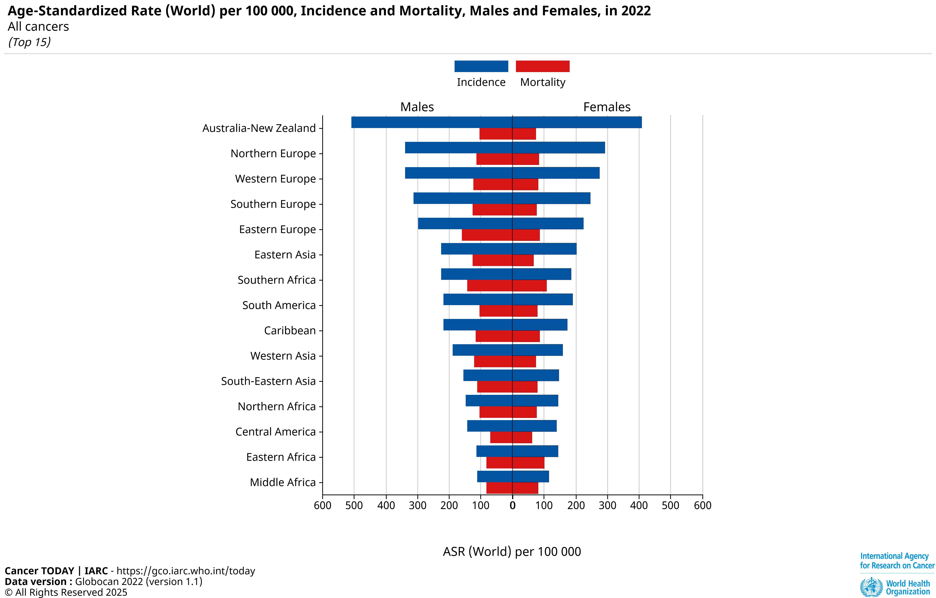
Australia has very high cancer incidence

Slide 5
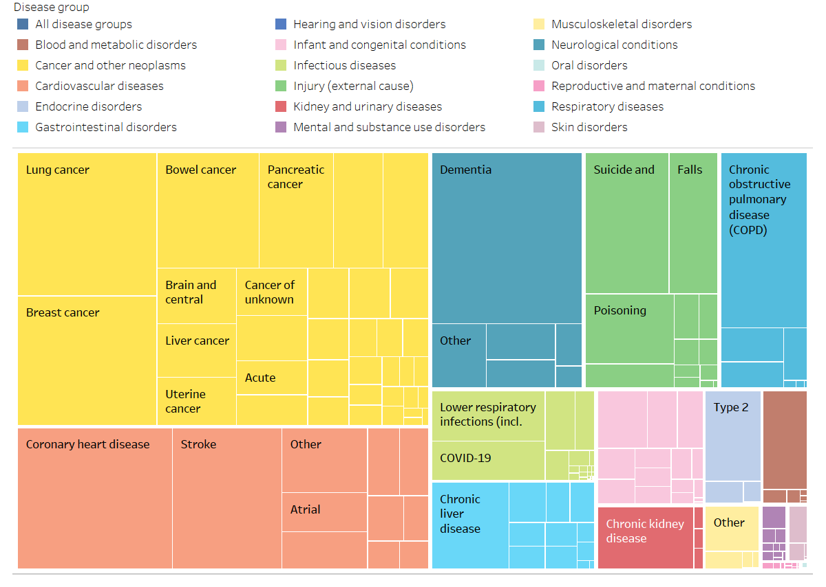
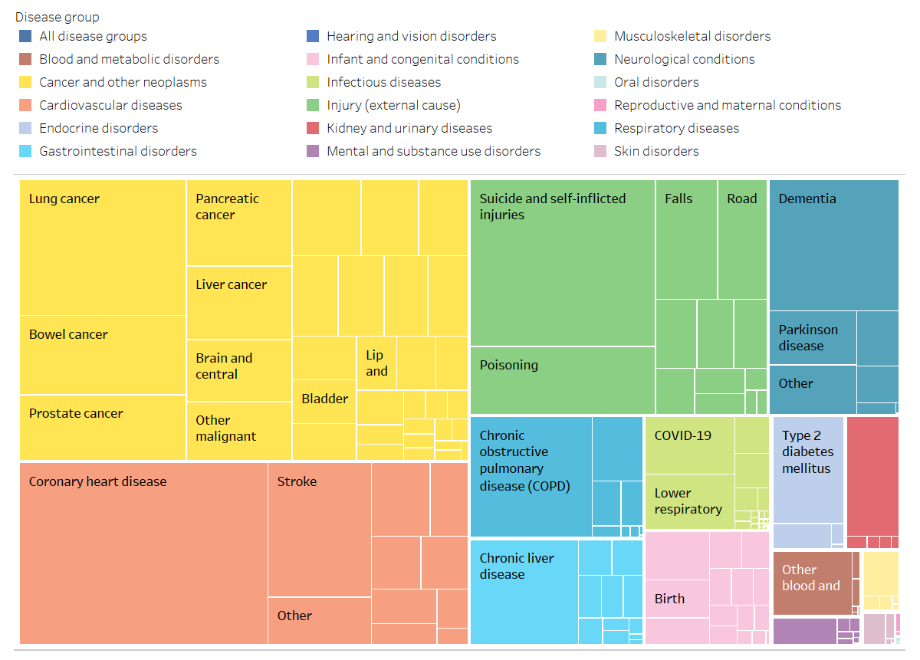
Cancer is the major health burden in Australia
Years of life lost in 2024
Females
Males
Cancers 34.3%
Neuro
11.1%
Injury
9.7%
Cancers 31.0%
Injury
17.2%
Neuro
7.6%
CVD 17.8%
CVD 20.2%
Source: AIHW, Australian Burden of Disease Study: Fatal burden of disease 2024. Australian Burden of Disease Study series no. 1. Cat. no. BOD 1. Canberra: AIHW

Slide 6

Top 10 cancers in Australia by counts
Males
Females
19,993
14,568
8,351
6,800
6,734
4,835
6,409
4,102
2010

Slide 7
Top 10 cancers for Australia by hospitalisations
Site | Number
Non-melanoma skin | 120,724
Prostate | 44,540
Unknown site | 43,639
Bowel | 28,537
Breast | 27,340
Leukaemia | 25,790
Lymphoma | 23,292
Lung | 21,006
Myelodysplasia | 17,707
Melanoma | 12,916
2019-20

Slide 8
Strategies for cancer control
Primary prevention
Secondary prevention
Tertiary prevention
Causal factors
Screening / Detection
Treatment
Onset of cancer
Diagnosis of cancer
Death
Birth

Slide 9
Strategies for cancer control
Primary prevention
Secondary prevention
Tertiary prevention
Causal factors
Screening / Detection
Treatment
Onset of cancer
Diagnosis of cancer
Death
Birth

Slide 10
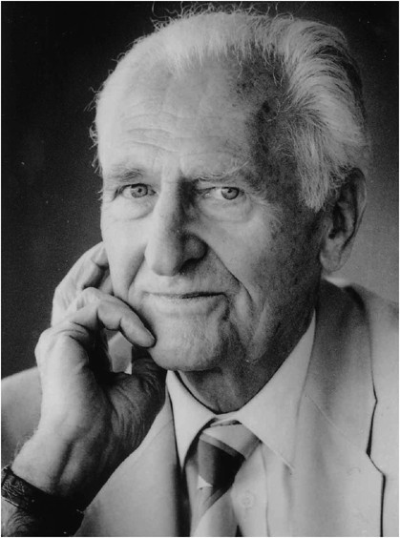
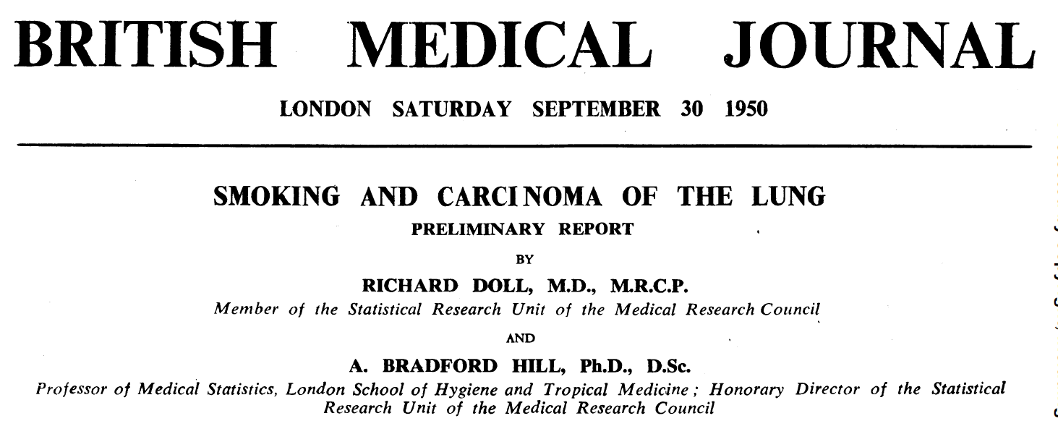

Slide 11
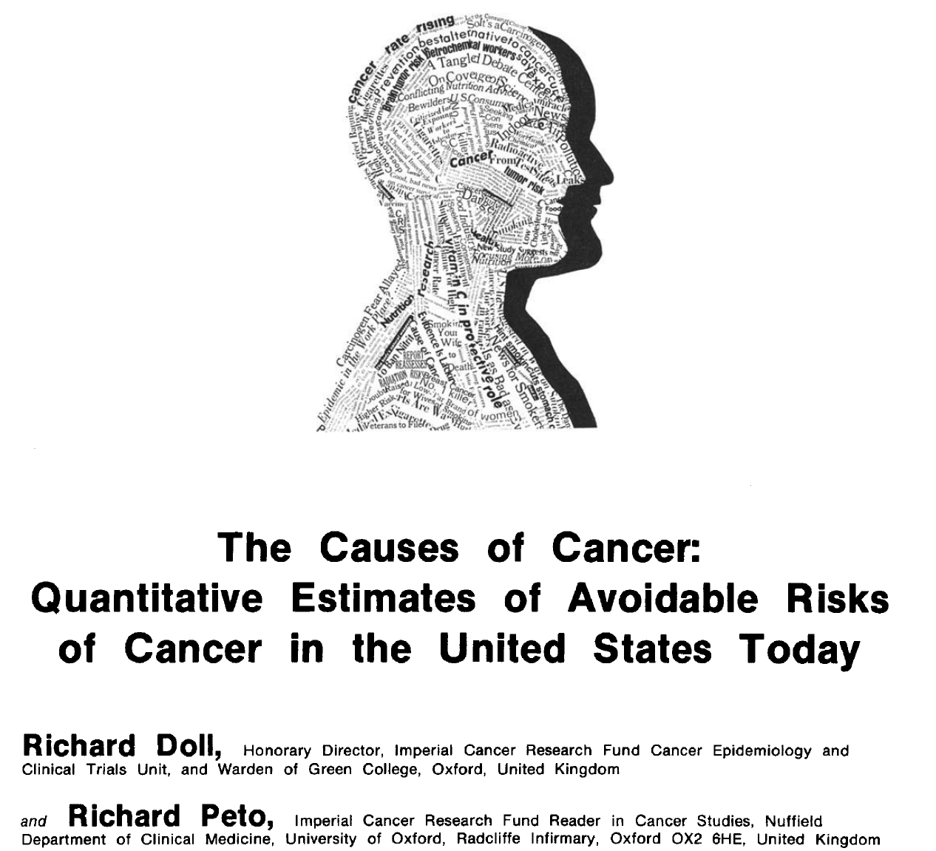

Slide 12

The Brief
Cancer Council Australia
Public Health Committee
“The report of this project will provide estimates of case numbers for the proportion of cancer cases that are preventable, from the most recent year for which incidence data are available (e.g. 2008), to the year 2020 or beyond”

Slide 13
Outline
Background
Methodology
PAFs by Exposure
Impact

Slide 14
Some methodology
“The population attributable fraction is the proportion by which the incidence rate of the outcome among the entire population would be reduced if the exposure were eliminated.”
Last, Dictionary of Epidemiology 3rd Edition.
I_{p}- I_{o}
PAF
=
I_{p}

Slide 15
1.5
1.0
Cases of cancer
Rate ratio
0.0
60%
“healthy weight”
“overweight”
40%
© Queensland Institute of Medical Research | 15

Slide 16
Total number of cases
in population
N=120
60%
“healthy weight”
“overweight”
40%
© Queensland Institute of Medical Research | 16

Slide 17
Number of cases
in population
not attributable to exposure
N=100
60%
“healthy weight”
“overweight”
40%
© Queensland Institute of Medical Research | 17

Slide 18
PAF
Number of excess cases
20
=
=
Total number of cases
120
Number of excess cases
in population
attributable to exposure
N=20
= 16.7%
Number of cases
in population
not attributable to exposure
N=100
60%
“healthy weight”
“overweight”
40%
© Queensland Institute of Medical Research | 18

Slide 19
1.5
Same RR
1.0
Rate ratio
0.0
40%
60%
Higher prevalence
“healthy weight”
“overweight”
© Queensland Institute of Medical Research | 19

Slide 20
Number of cases
in population
not attributable to exposure
N=100
40%
60%
Higher prevalence
“healthy weight”
“overweight”
© Queensland Institute of Medical Research | 20

Slide 21
PAF
Number of excess cases
30
=
=
Total number of cases
130
= 23%
Number of excess cases
in population
attributable to exposure
N=30
Number of cases
in population
not attributable to exposure
N=100
40%
“healthy weight”
“overweight”
60%
© Queensland Institute of Medical Research | 21

Slide 22
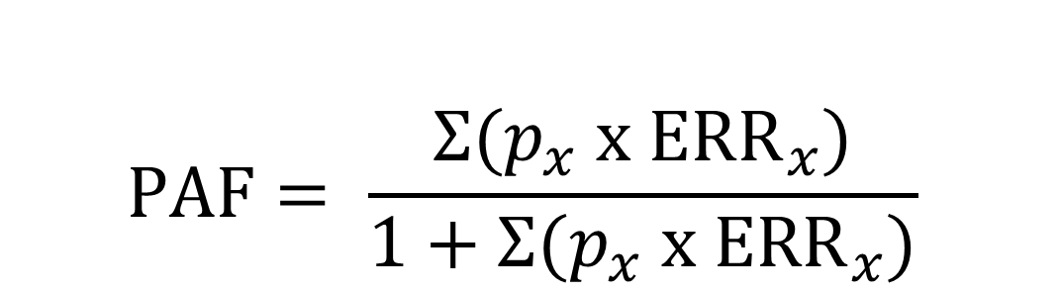
The standard PAF formula
$$PAF= \frac{Σ(p_{x} x {ERR}_{x})}{1+Σ(p_{x} x {ERR}_{x})}$$
p_{x} is the proportion of the population in exposure level x
ERR_{x} the excess relative risk (RR_{x} ─ 1) associated with exposure level x.

Slide 23
Overview of process
Task | Source
Assess causality | WCRF, IARC, (USPSTF)
Obtain prevalence data | Australian National Health Survey Other national collections Population-based epi studies Grey literature
Obtain risk estimates | WCRF, IARC, meta-analyses
Generate PAF estimates | Variations of PAF formula Tobacco: Peto method UVR: counterfactual method

Slide 24
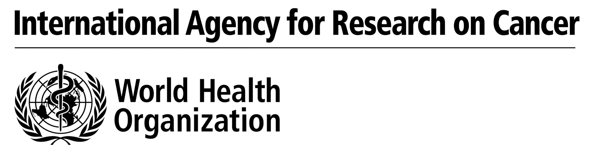
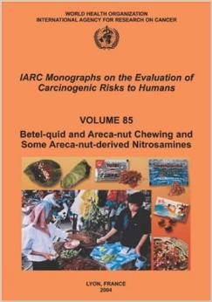
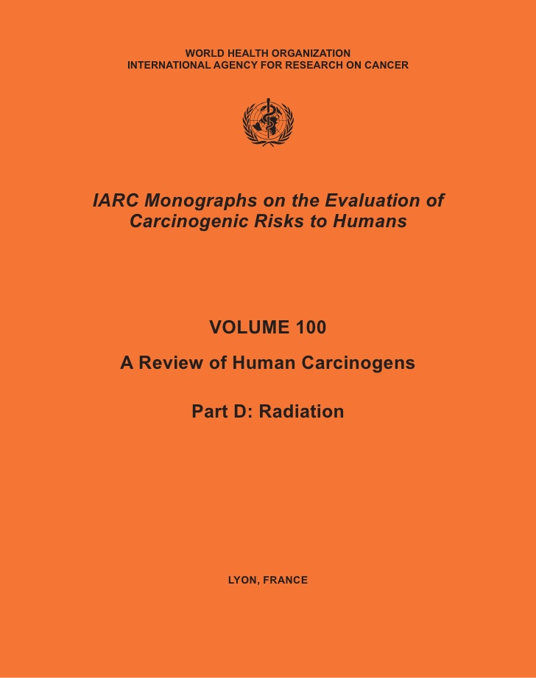
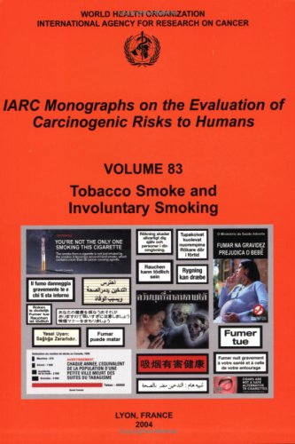
The causes of cancer - specifically
Group 1: Carcinogenic to humans. (Sufficient evidence in humans).
Group 2A: Probably carcinogenic to humans. (Limited evidence in humans, but sufficient in animals, or strong mechanistic evidence).
Group 2B: Possibly carcinogenic to humans. (Limited evidence in humans and less than sufficient in animals, or strong mechanistic evidence).
Group 3: Not classifiable as to its carcinogenicity to humans. (Data is inadequate or conflicting).
Group 4: Probably not carcinogenic to humans. (Strong evidence of no carcinogenicity).

Slide 25
Assess causality
13
6
3
11
8
3
1
4
5
1
3
2
1
61 causal associations (+ supplementary associations)

Slide 26
Outline
Background
Methodology
PAFs by Exposure
Impact

Slide 27
Numbers of excess cancers due to causal factors

Slide 28
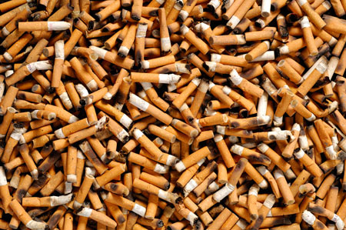
The number of excess cancers due to tobacco

Slide 29
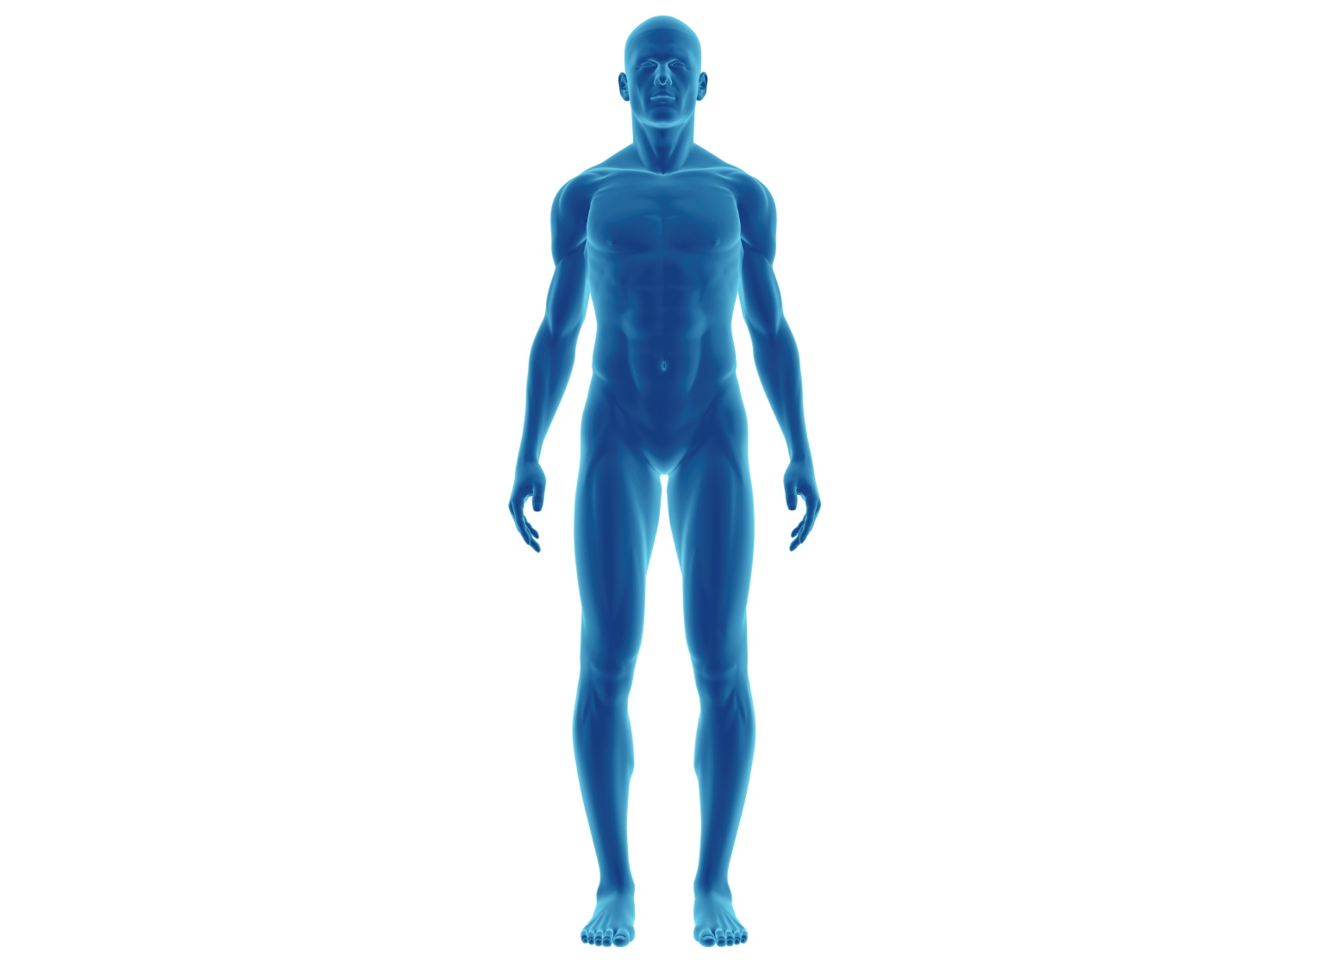
Tobacco causality
Oral cavity
Pharynx
Larynx
Oesophagus
Lung
Liver
Pancreas
Kidney
Stomach
Bladder
Colon & Rectum
Cervix & Ovary
Myeloid leukaemia

Slide 30
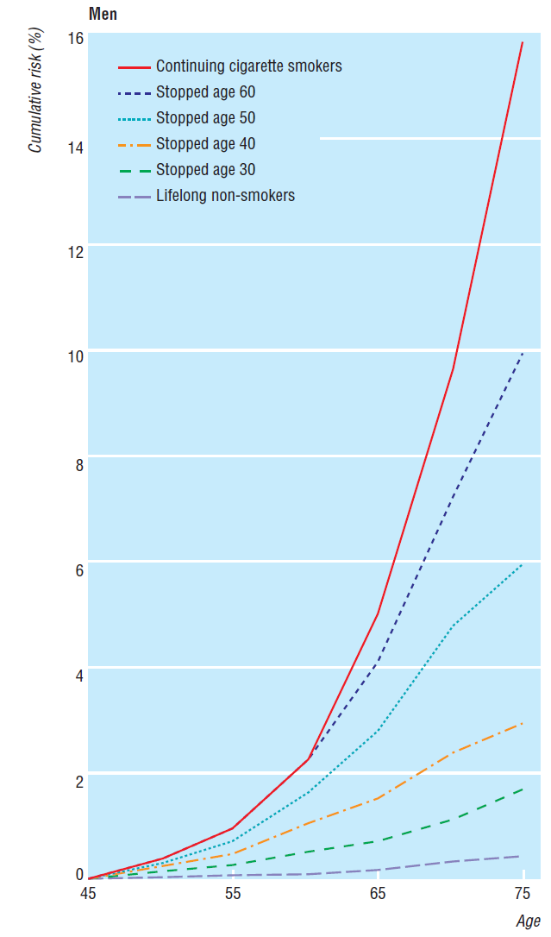
The Peto Method
Lung cancer incidence in current smokers
Lung cancer
  Assumes all excess lung cancers are due to smoking
  Use RR of current smoking to back-calculate the ‘notional prevalence’ of current smoking
Other smoking-related cancers
  Apply standard PAF formula
  Use notional prevalence of current smoking
  Use RR for cancer sites associated with current smoking
Lung cancer incidence in never-smokers

Slide 31
Numbers of excess cancers due to tobacco
Cancer sites | Excess
Lung | 8273
Oropharynx | 1860
Colorectum | 944
Oesophagus | 792
Pancreas | 605
Larynx | 463
Stomach | 389
Liver | 264
Uterine cervix | 56
15 522 (PAF 13.3%)

Slide 32
Proportion of excess cancers due to tobacco
Males
Females
6%
7%
84%
77%
71%
2%
26%
23%
34%
11%
24%
51%
24%
7%
24%
11%
59%
26%
16%
4%
77%
62%
11%
73%

Slide 33
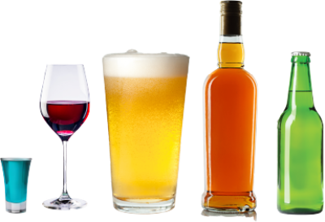
The number of excess cancers due to alcohol

Slide 34
Alcohol causality
Oral cavity
Pharynx
Larynx
Oesophagus SCC
Breast
Liver
Colon & Rectum

Slide 35
Australian Guidelines for Alcohol
There is no ‘safe dose’ for alcohol
Recommend
No more than two standard drinks on any day to reduce the lifetime risk of harm from alcohol-related disease or injury; and
No more than four standard drinks on a single occasion to reduce the risk of alcohol-related injury arising from that occasion

Slide 36
What is a ‘standard drink’?
In Australia….
One drink = 10g ethanol = 12.5mL pure alcohol

Slide 37
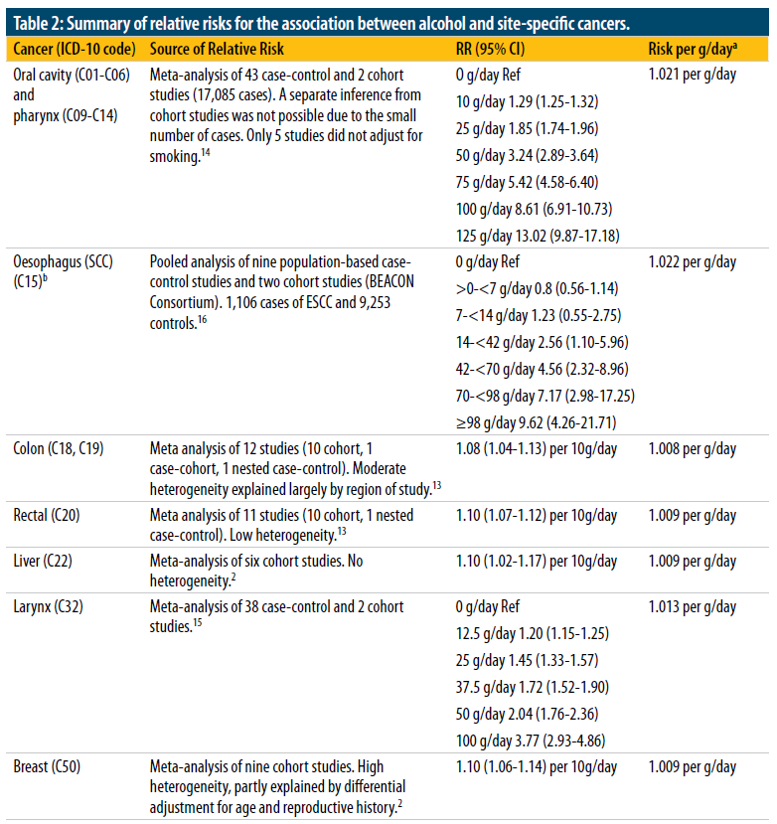
What are the risks of cancers?

Slide 38
Alcohol – intake in Australian males
Source: 2001 Australian National Health Survey, Confidentialised Unit Record File
0
drinks/day

Slide 39
How many excess cancers are due to any alcohol intake?
Cancer sites | Excess
Colorectum | 1338
Breast | 830
Oropharynx | 613
Liver | 175
Oesophagus | 126
Larynx | 84
3 208 (PAF 2.7%)

Slide 40
Proportion of excess cancers due to alcohol
Males
Females
6%
13%
4%
25%
9%
15%
6%
10%
5%
43%
7%

Slide 41
What if we reduce intake to <2 drinks/day?
Source: 2001 Australian National Health Survey, Confidentialised Unit Record File
< 2 standard drinks/day

Slide 42
What if we reduce intake to <2 drinks/day?
Source: 2001 Australian National Health Survey, Confidentialised Unit Record File
< 2 standard drinks/day

Slide 43
What if we reduce intake to <2 drinks/day?
Source: 2001 Australian National Health Survey, Confidentialised Unit Record File
1442 fewer cancers
Cancers prevented | N | PIF
Colorectum | 618 | 5.9%
Breast | 225 | 1.6%
Oesophagus | 73 | 14%
Oropharynx | 368 | 19%
Liver | 89 | 6.3%
Larynx | 69 | 11%
< 2 standard drinks/day

Slide 44
What if we reduce intake to <4 drinks/day?
Source: 2001 Australian National Health Survey, Confidentialised Unit Record File
745 fewer cancers
Cancers prevented | N | PIF
Colorectum | 312 | 3.1%
Breast | 77 | 0.5%
Oesophagus | 44 | 8.7%
Oropharynx | 227 | 11%
Liver | 46 | 3.3%
Larynx | 39 | 6.2%
< 4 standard drinks/day

Slide 45
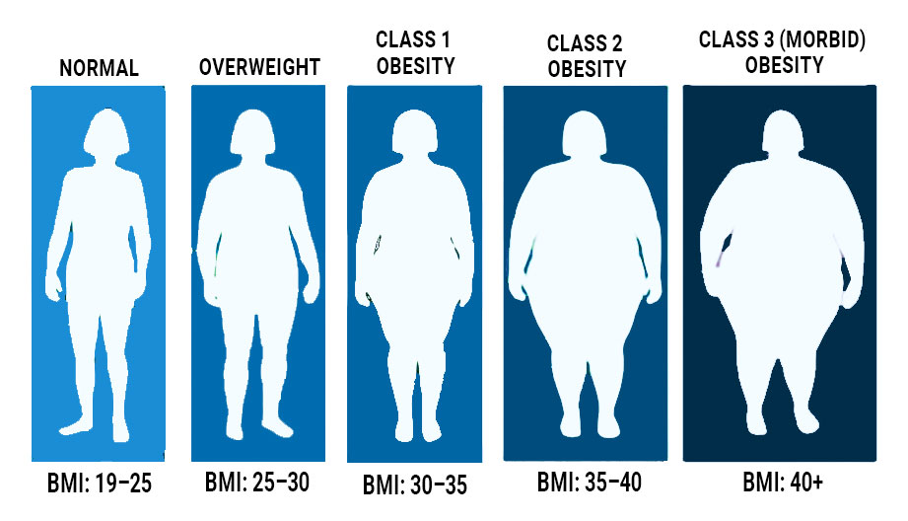
How many excess cancers are due to obesity?

Slide 46
Overweight and obesity - causality
Oesophageal adenocarcinoma
Breast
Gallbladder
Pancreas
Kidney
Ovary
Endometrium
Colon & Rectum
Prevalence in Australia | 52% men 37% women (2001 National Health Survey)

Slide 47
How does excess body fat cause cancer?
Metabolic pathways
Hormonal pathways
Oesophagus
Endometrium
Breast
Target cell
Reduced repair and control
Increased cell turnover
Tumour development

Slide 48
How many excess cancers are due to obesity?
Cancer site | Excess
Colon | 1073
Breast | 812
Endometrium | 557
Kidney | 513
Rectum | 216
Oesophagus | 211
Pancreas | 196
Ovary | 48
Gall bladder | 41
3 920 (PAF 3.4%)

Slide 49

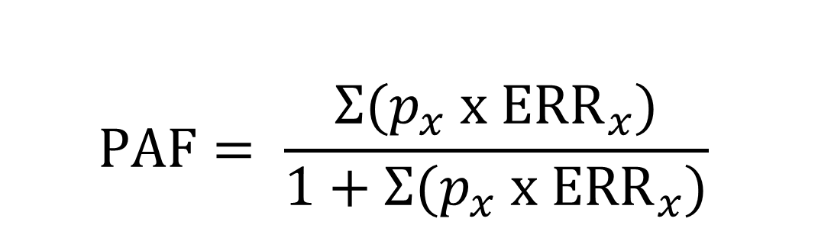
Solar ultraviolet radiation
SCC
BCC
Melanoma
$$PAF= \frac{Σ(p_{x} x {ERR}_{x})}{1+Σ(p_{x} x {ERR}_{x})}$$

Slide 50
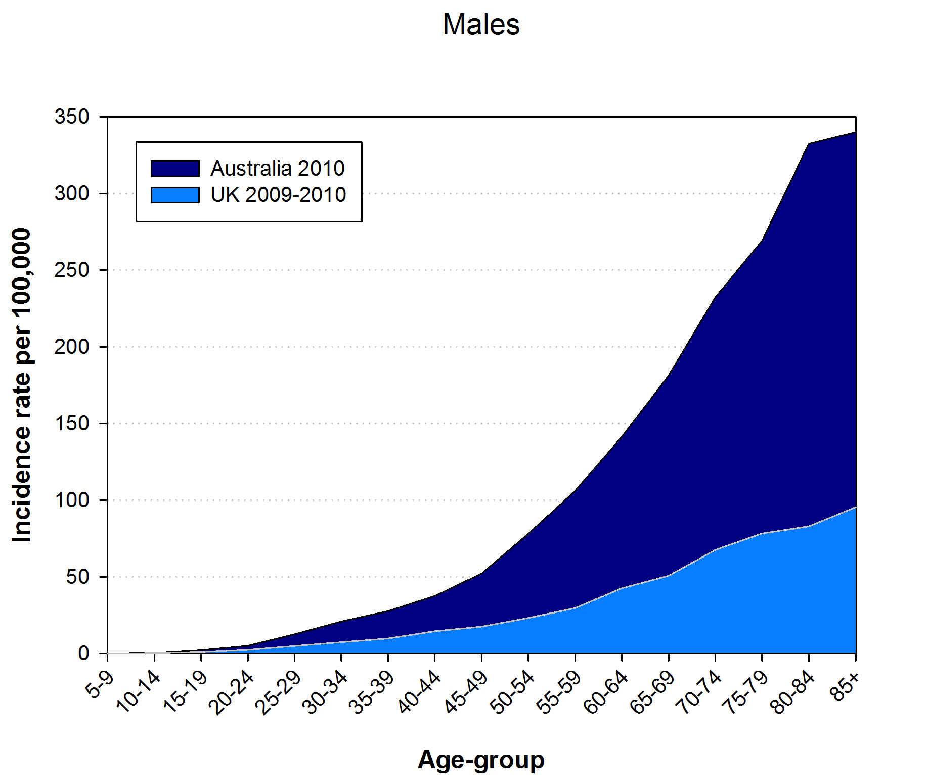
Counterfactuals: which populations are “unexposed” to UVR?
Melanoma incidence
Australia vs UK
Melanoma incidence attributable to residing in Australia
(“exposed”)
70% excess
PAF 63%
Melanoma incidence attributable to residing in UK
(“unexposed”)
Malignant melanoma incidence rates in Australia 2009 and in the UK 2009-2011

Slide 51
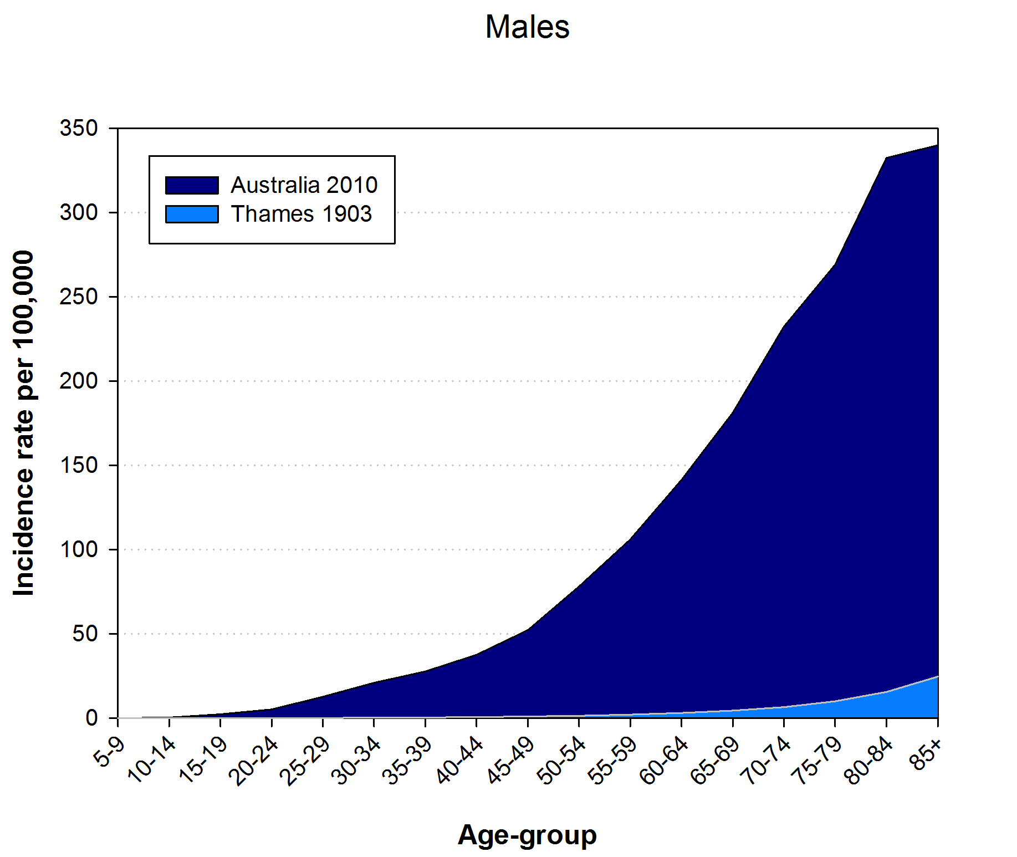
Counterfactuals: which populations are “unexposed” to UVR?
Melanoma incidence
Australia vs UK
“time shift”
Melanoma incidence attributable to residing in Australia
(“exposed”)
PAF 95%
Melanoma incidence attributable to residing in UK
(“unexposed”)
Malignant melanoma incidence rates in Australia 2009 and in the UK 1903

Slide 52

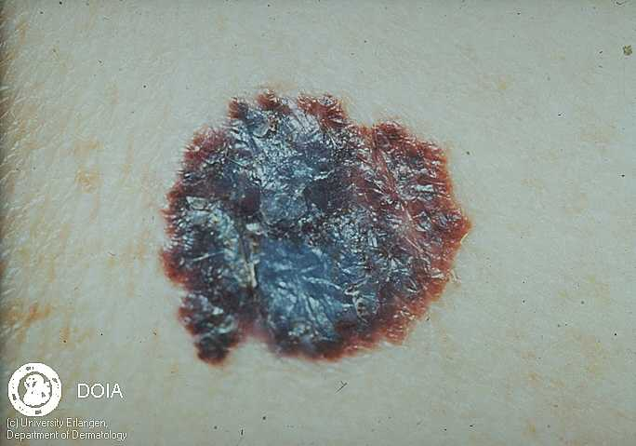
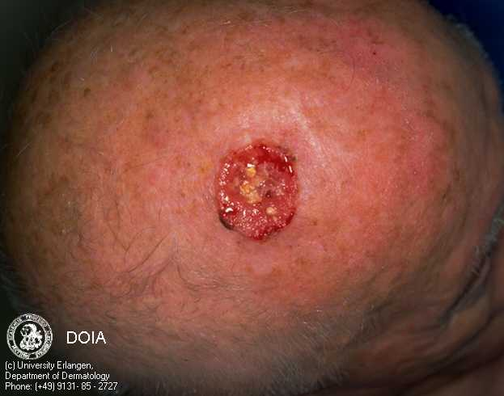
How many skin cancers have been prevented?
Melanoma
Squamous cell cancers

Slide 53
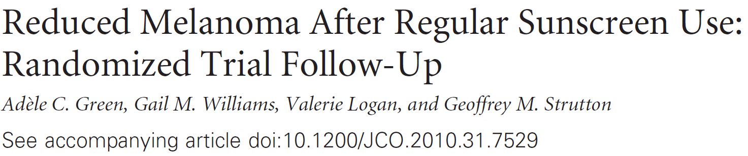
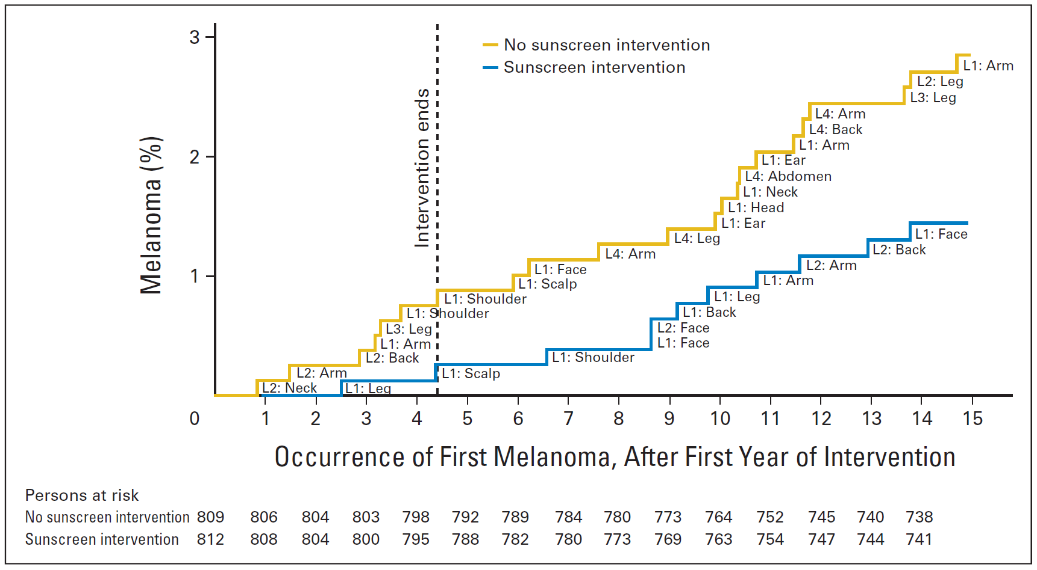
HR 0.50
(0.24-1.02)

Slide 54
How many melanomas have been prevented?
1.0
Cases of melanoma
0.5
Rate ratio
Source: Green et al, J Clin Oncol. 2011; 29:257-263
0.0
no sunscreen
daily sunscreen
© Queensland Institute of Medical Research | 54

Slide 55
How many melanomas have been prevented?
“Prevented
Fraction”
1.0
Cases of melanoma
0.5
Rate ratio
Source: Green et al, J Clin Oncol. 2011; 29:257-263
0.0
no sunscreen
daily sunscreen
© Queensland Institute of Medical Research | 55

Slide 56
How many skin cancers have been prevented?
Agent | Prevalence | Cancer | Effect size
Sunscreen Regular use SPF15+ when outdoors | M / F 21% / 35% | Melanoma | 0.50 (0.24-1.02)
 |  | SCC Skin | 0.65 (0.45-0.94)

Slide 57
How many skin cancers have been prevented?
Agent | Prevalence | Cancer | Effect size | Number prevented (PF)
Sunscreen Regular use SPF15+ when outdoors | M / F 21% / 35% | Melanoma | 0.50 (0.24-1.02) | 1,729 (14%)
 |  | SCC Skin | 0.65 (0.45-0.94) | 14,192 (9.3%)

Slide 58
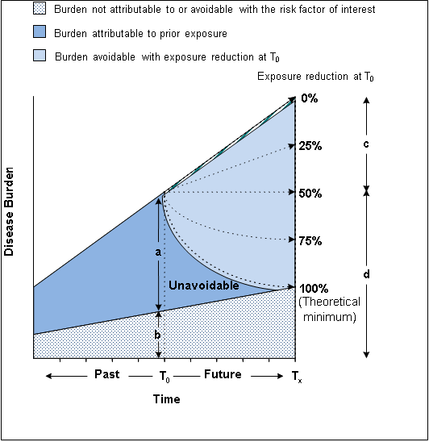
What might be achieved? Modelling sunscreen use…
The potential impact fraction (PIF) is the proportional change in disease incidence following a change in the prevalence of exposure to a causal factor
Barendregt (2010). J Epidemiol Community Health 64: 209-2012
Notes:
Potential Impact Fraction: estimates the proportional change in average disease incidence (or mortality) that results from a change in the exposure of a causally-related risk factor

Slide 59
What might be achieved? Modelling sunscreen use…
Source: Olsen et al. Br J Dermatol 2018
Model | Key Assumptions
Theoretical maximum | 100% sunscreen use, immediate uptake, immediate effect
Full Uptake | 100% sunscreen use, over 10 years
Partial Uptake | Sunscreen use increases by 5% p.a., over 10 years
Working-age intervention | 100% sunscreen use, people of “prime” working-age (20-45 years), 100% usage continues as cohort ages
School-based intervention | 100% sunscreen use, school-aged children (0-17 years), 100% usage continues as cohort ages

Slide 60
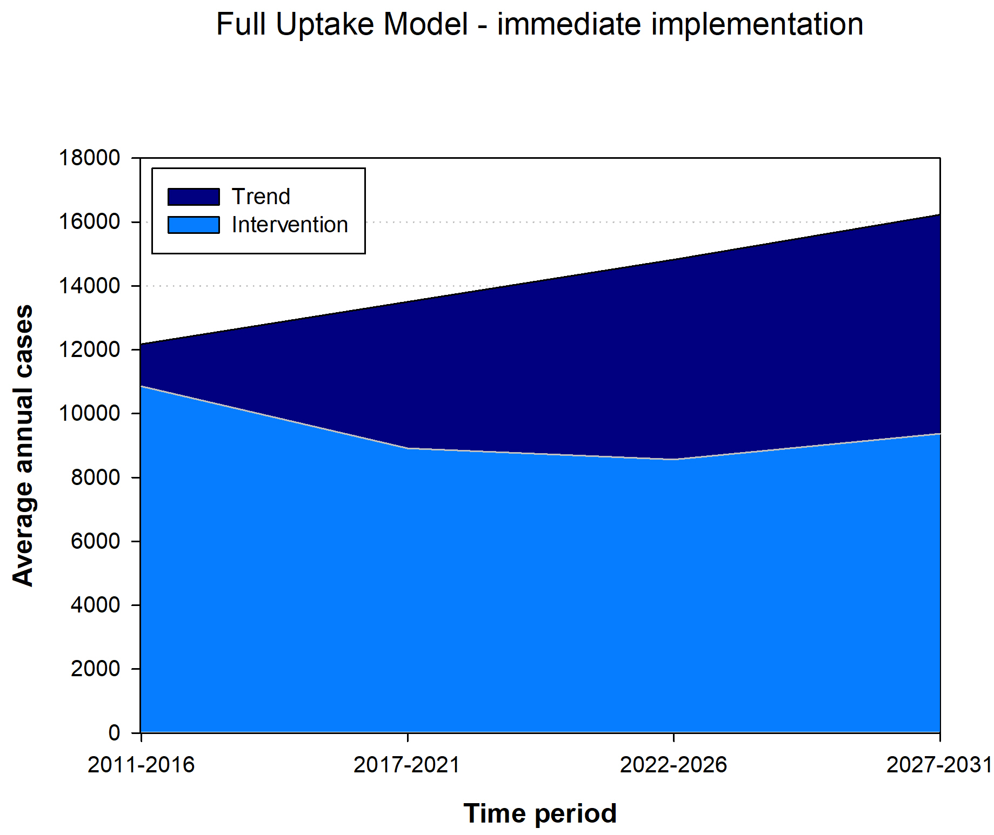
What might be achieved? Modelling sunscreen use…
“Theoretical maximum”
Source: Olsen et al. Br J Dermatol 2018
Melanomas prevented
33%

Slide 61
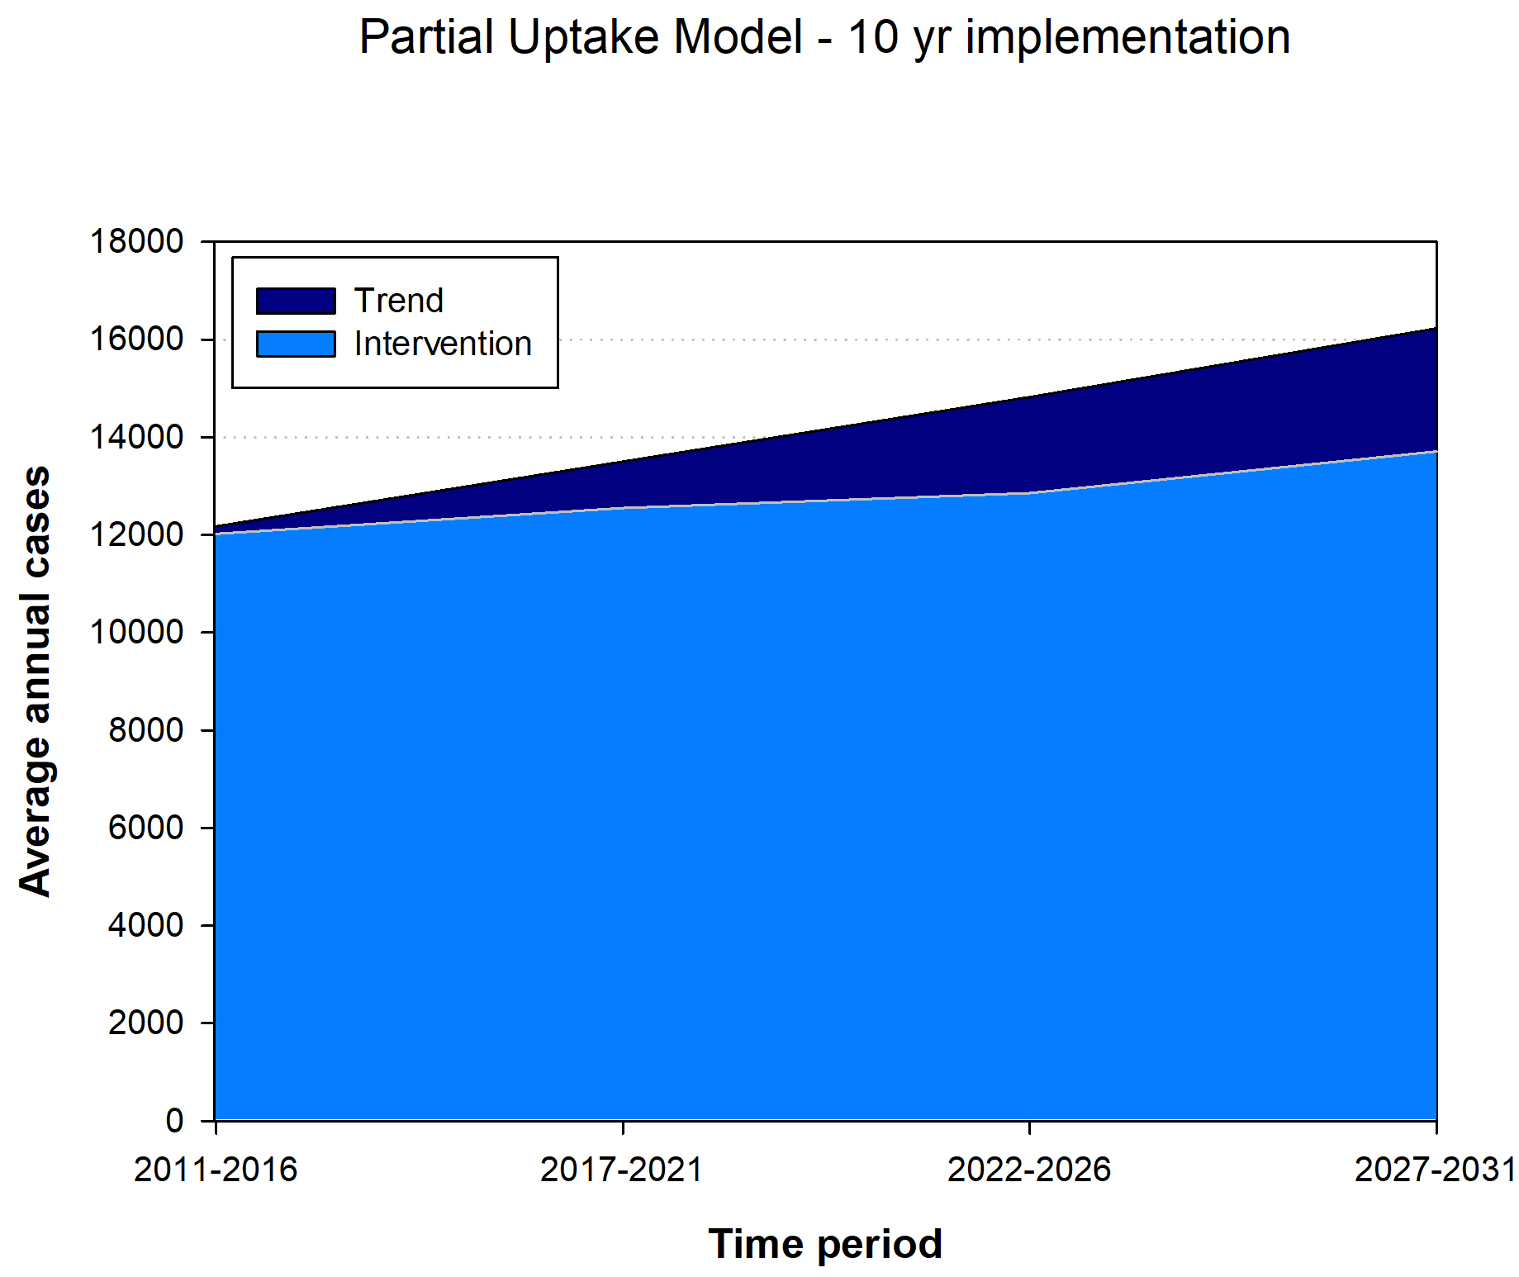
What might be achieved? Modelling sunscreen use…
Increase sunscreen at 5% p.a.
Source: Olsen et al. Br J Dermatol 2018
“Plausible model”
Melanomas prevented
16%

Slide 62
So, how many cancers in total are potentially preventable?
13
6
3
11
8
3
1
4
5
1
3
2
1
61 causal associations (+ supplementary associations)

Slide 63
So, how many cancers in total are potentially preventable?
Primary analysis – combined PAF 32%
      ≈ 36,626 cancers
      33% in men
      31% in women
Supplementary cancers – combined PAF 33%
      ≈ 37,778 cancers
      34% in men
      32% in women
  Overweight and obesity
  Melanoma (men only)
  Thyroid
  Non-Hodgkin’s lymphoma
  Multiple myeloma
  Leukaemia
  Insufficient breast feeding
  Ovary
  HRT
  Breast (Oestrogen-only)
  Ovary (Combined)

Slide 64
Total PAFs for each exposure

Slide 65
Total PAFs for each exposure
Meat-related cancers | Excess
Colon | 1700
Rectum | 914
Fibre-related cancers | Excess
Colorectum | 2609
Fruit + vege-related cancers | Excess
Lung | 989
Oral cavity / pharynx | 370
Oesophagus | 270
Stomach | 152
Larynx | 75

Slide 66
Total PAFs for each exposure
Infection-related cancers | Agent | Excess
Cervix | HPV | 818
HNSCC | HPV | 381
Anus | HPV | 288
Vulva | HPV | 120
Vagina | HPV | 61
Penis | HPV | 38
Kaposi Sarcoma | HIV/KSHV | 60
Liver | HBV/HCV | 483
Stomach | H. Pylori | 694
Non-Hodgkin’s Lymphoma | H pylori, EBV, HCV, HIV | 163
Hodgkin’s Lymphoma | EBV | 188
Nasopharynx | EBV | 79
3,421 cancers

Slide 67
Top 10 cancers (M) - % preventable

Slide 68
Top 10 cancers (F) - % preventable

Slide 69
Cancers with highest preventable fractions
PAF >80%
PAF 40-80%
PAF 20-40%

Slide 70
Outline
Background
Methodology
PAFs by Exposure
Impact

Slide 71
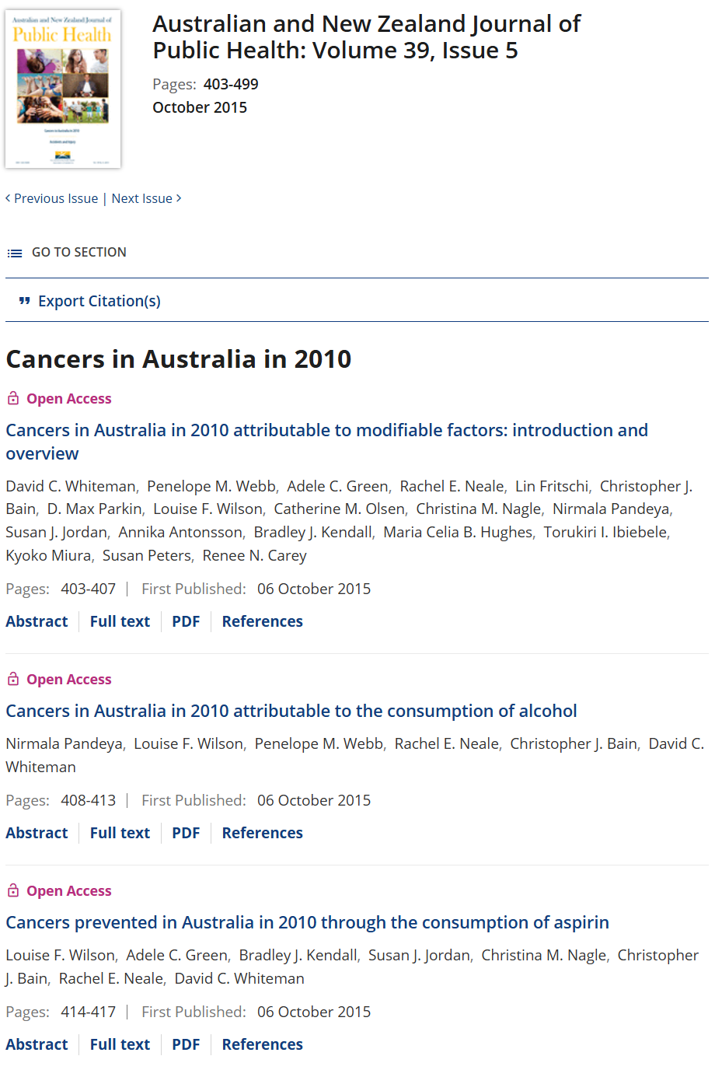
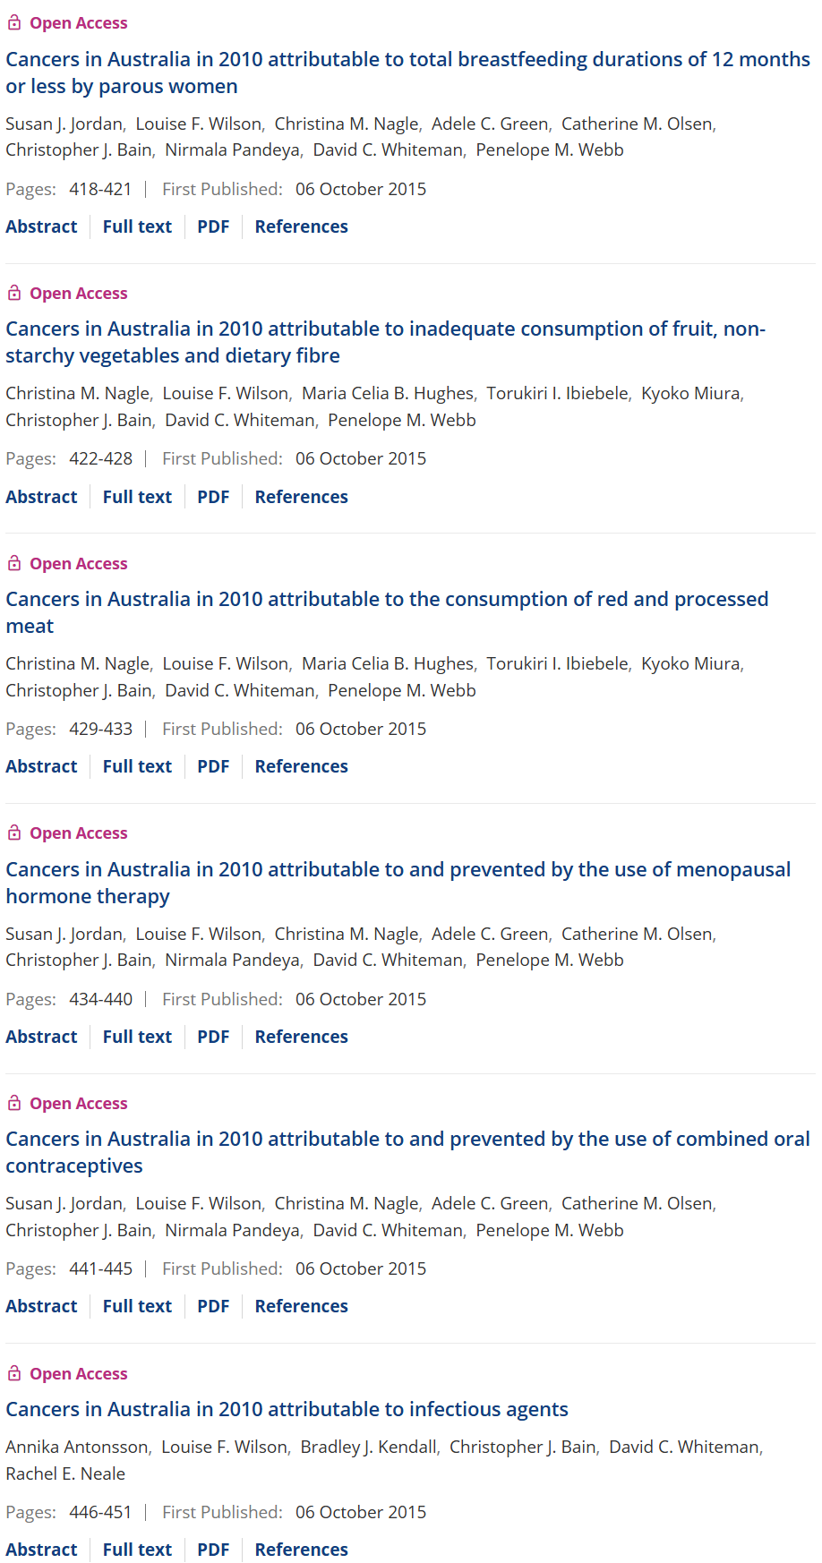
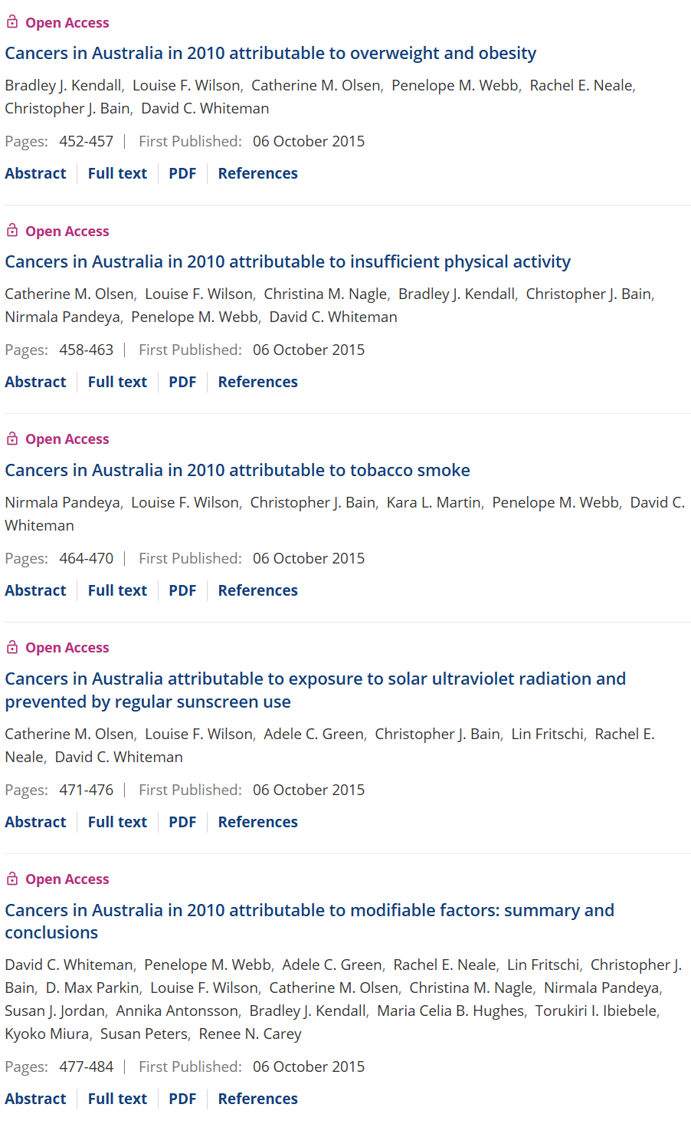
858 citations (GS)

Slide 72
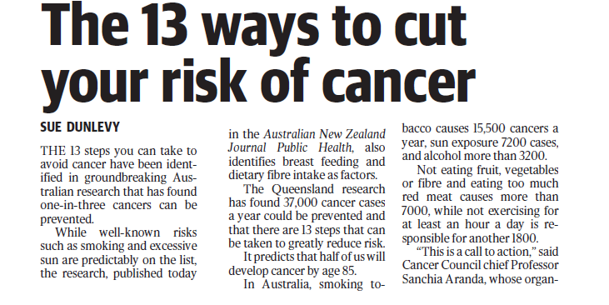
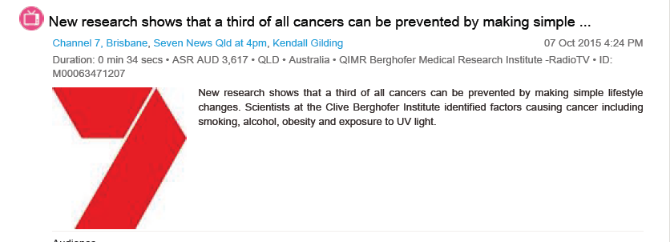

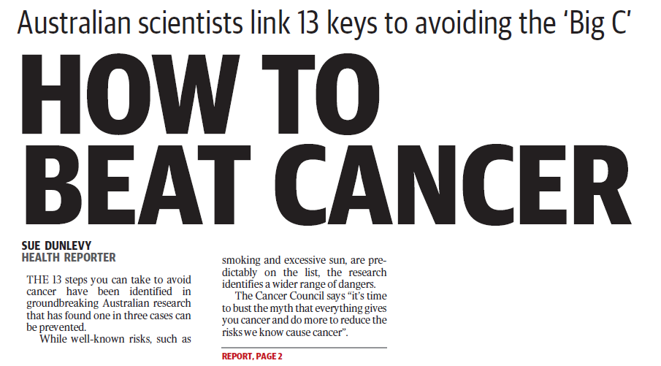
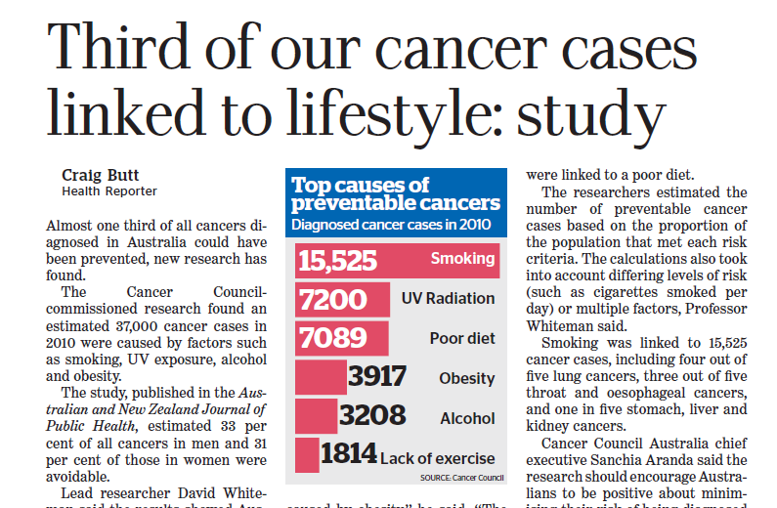
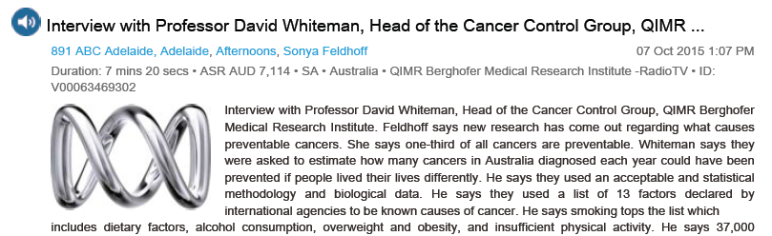
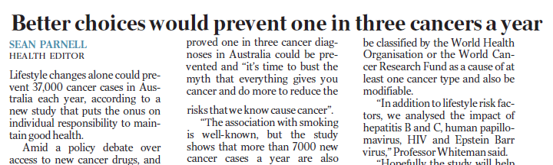
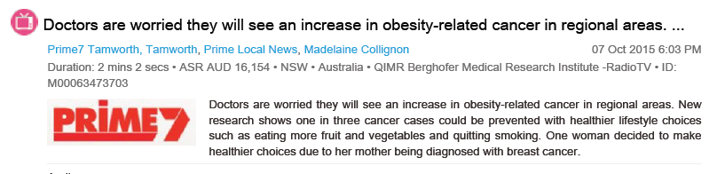
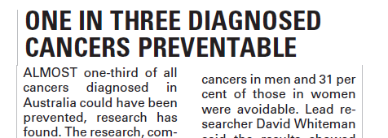
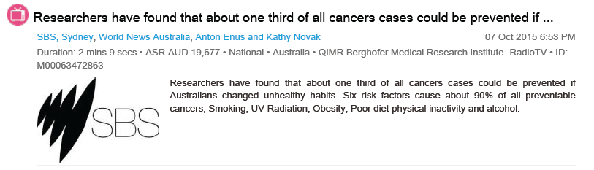
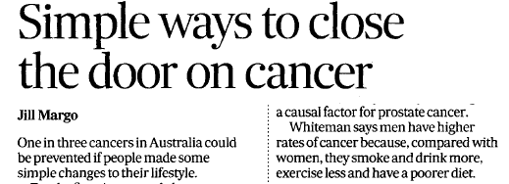
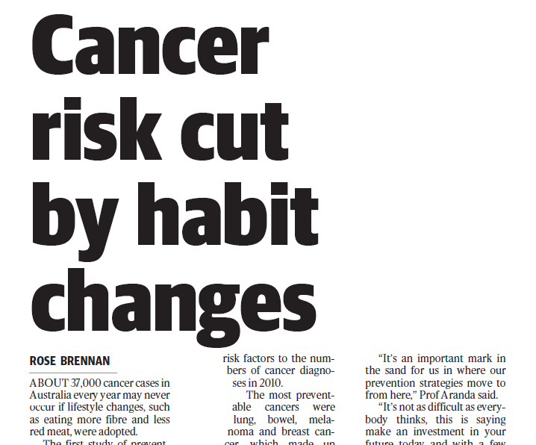
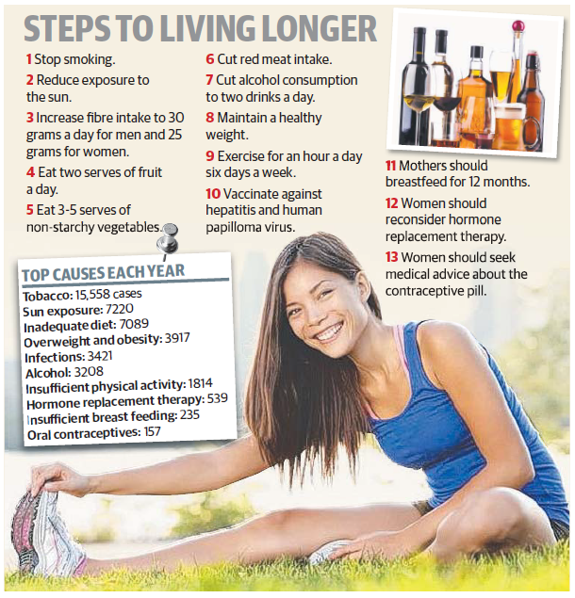
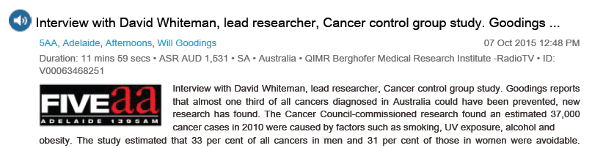
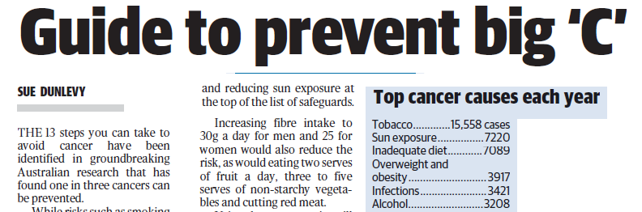
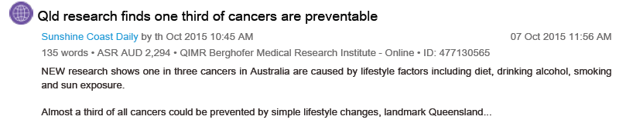
Impact

Slide 73
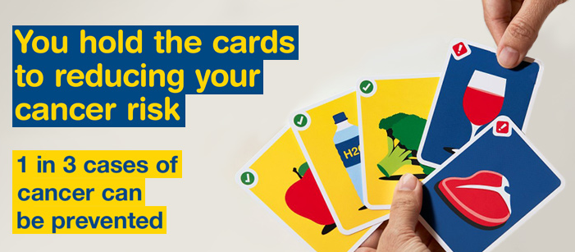

Translation to policy
Television commercial
Social media and digital marketing
Website: http://www.cancercouncil.com.au/1in3cancers/ (including cancer risk quiz)
Notes:
In 2015, the results of the project were published as 14 open access articles in the ANZJPH

Slide 74
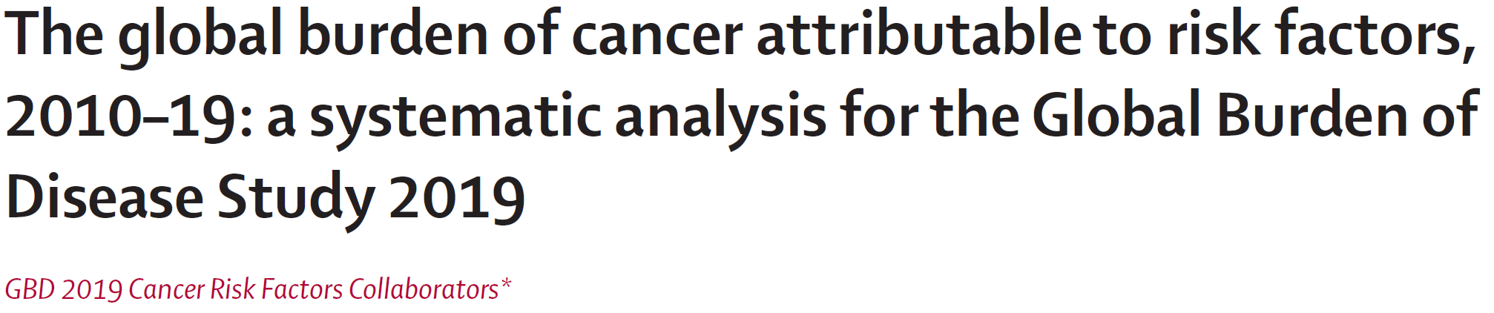

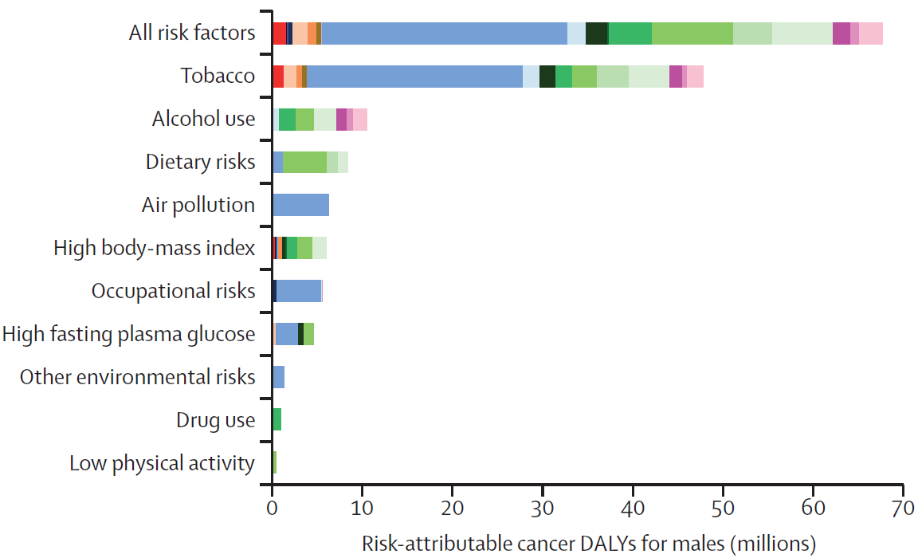
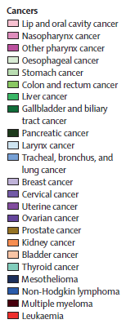
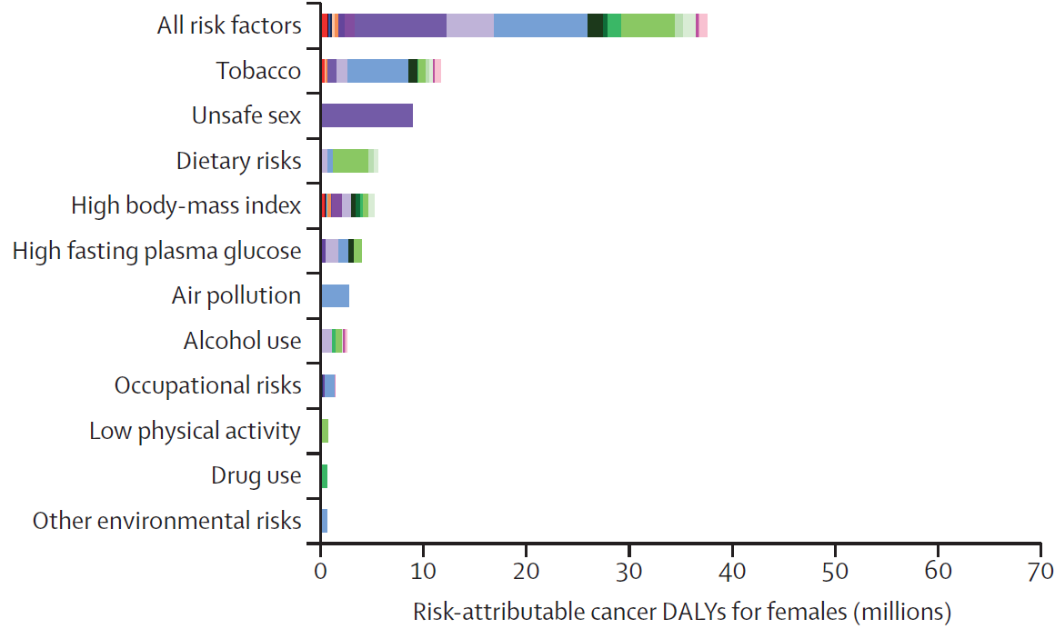
Global PAF for cancer
Males
Females

Slide 75




Global PAF for cancer
Environmental
Behavioural
Metabolic

Slide 76
Attributable deaths and mortality rate
South Africa
% of risk-attributable
cancer deaths
over total cancer deaths (95% UI) 45.5% (42.3-49.0)

Slide 77


Slide 78
Acknowledgements
Cancer Council Australia
Public Health Committee
Associate Investigators
Annika Antonsson
Renee Carey
Maria Celia Hughes
Torukiri Ibiebele
Susan Jordan
Bradley Kendall
Kyoko Miura
Christina Nagle
Catherine Olsen
Nirmala Pandeya
Susan Peters
Research Assistant
Louise Wilson
Advisors
Christopher Bain
Max Parkin
Chief Investigators
David Whiteman
Head, Cancer Control Group
Penelope Webb
Head, Gynaecological Cancers Group
Adele Green
Head, Cancer and Population Studies Group
Rachel Neale
Head, Cancer Aetiology and Prevention Group
Lin Fritschi
Head, Epidemiology Group, Curtin University, Perth
Questions: david.whiteman@qimrberghofer.edu.au

